Slide 1
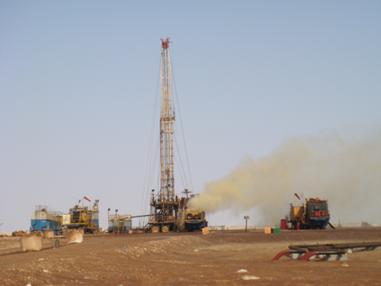
Process Safety Alert
Use this Alert: Discuss in Tool Box Talks and HSE Meetings ➔ Distribute to contractors ➔ Post on HSE Notice Boards ➔ Include in site HSE Induction
Targeted audience: Wells
Leaking A-annulus SOV
Gas Leak from SOV (July, 2019)
What happened?
A well was expected to produce with a GOR of 100 m3/m3 but the actual GOR turned out to be 5x higher. As a result, when started up and lined up to the station its production resulted in slugging operation. To prevent slugging a Well Test Unit was hooked up at the well site. As a result, pressure was also building up in the A-annulus and was exceeding the MAASP. The pressure from the A-annulus was bled off to the Well Test Unit using the outer Side Outlet Valve. This was done several times and led to the washing out of the valve body resulting in a leak. That leak occurred 3 days after the Well Test Unit was put into operation. By closing the inner SOV the leak was arrested and the well remained in operation via the tubing and the Well Test Unit to the station for several days before the leaking valve was replaced.
Similar Incident: Gas Leak from SOV leading to blowout (Sep, 2008)
What happened?
After chemically cutting the tubing, gas built up in the annulus. During well circulations, the inner annulus Side Outlet Valve (SOV) was operated to control & bleed off gas via a line connecting the wellhead directly to the waste pit. Inner SOV was kept partially open to continuously bleed off gas while electric line equipment was rigged down. Catastrophic failure of the SOV occurred when the SOV body cracked and uncontrolled well fluids were released. Since the integrity of the inner SOV was lost, no means remained to shut in the well leading to a blowout.
Learning:
SOV shall not be used as a choke as per PR-1489 (Well Test Procedure) and SP-1213 (Well Control), instead a properly designed choke manifold shall be used.
“This document is restricted and it is distributed for information purposes only and it shall not be shared with other than PDO employees and contracts without PDO permission”.

