Slide 1
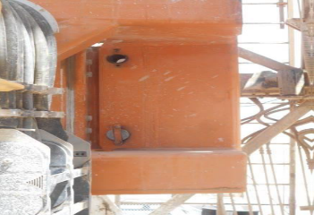
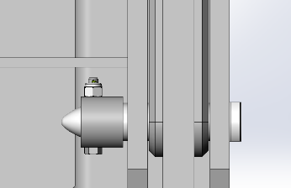
PDO Second Alert
Date: 1st April 2019 Incident : HIPo#20 DROPS
What happened?
While drilling 12 1/4 hole @ 950m one of the 4 steel pins (2.28kg) holding the TDS to the mast dolly system fell approximately 14meters to the rig floor. At the time of the incident excessive vibration was being experienced.
Learning from this incident.
Compliance to Red Zone Management saves lives
When high vibrations experienced during drilling
STOP DRILLING and pick up.
Inform rig manager and DSV
Perform DROPS inspection
When experiencing abnormal vibrations STOP and make sure equipment is secure.
Redesign of pin retention
Notes:
Ensure all dates and titles are input
A short description should be provided without mentioning names of contractors or individuals. You should include, what happened, to who (by job title) and what injuries this resulted in. Nothing more!
Four to five bullet points highlighting the main findings from the investigation. Remember the target audience is the front line staff so this should be written in simple terms in a way that everyone can understand.
The strap line should be the main point you want to get across
The images should be self explanatory, what went wrong (if you create a reconstruction please ensure you do not put people at risk) and below how it should be done.

Slide 2
Management self audit
Date: 1st April 2019 Incident : HIPo#20 DROPS
As a learning from this incident and ensure continual improvement all contract
managers must review their HSE HEMP against the questions asked below
Confirm the following:
Do you ensure that HEMP covers all vibration in different section holes.
Do you ensure that all personnel are aware how to manage unexpected and abnormal vibrations during drilling operations.
Do you ensure that both 3rd party DROPS inspections is carried out as required.
Do you ensure that the HEMP will be communicated in all JSA’s and SOP’s and communicated to all employees.
* If the answer is NO to any of the above questions please ensure you take action to correct this finding.
Notes:
Ensure all dates and titles are input
Make a list of closed questions (only ‘yes’ or ‘no’ as an answer) to ask others if they have the same issues based on the management or HSE-MS failings or shortfalls identified in the investigation.
Imagine you have to audit other companies to see if they could have the same issues.
These questions should start with: Do you ensure…………………?

