Slide 1
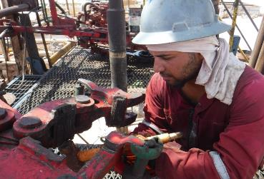
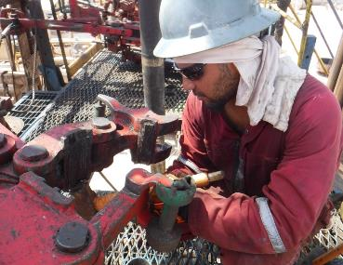
PDO Second Alert
Date: 21st May 2019 Incident title LTI eye injury
What happened?
Tool pusher and Roustabout were exchanging manual tong dies. While RB was hammering on die (from the bottom) as to remove it from its slot a small piece of metal hit him in right eye. IP was not wearing safety glasses. He was sent to Yibal PDO clinic and from there transferred to Ibri hospital.
Your learning from this incident..
Ensure TBT is covering all possible hazards and their controls are in place
Ensure to always wear full PPE required for the task
Use the appropriate Drive for removing the Dies
Intervene immediately if unsafe action seen (such as working without full PPE)
Always ensure to wear required PPE for the task
Notes:
Ensure all dates and titles are input
A short description should be provided without mentioning names of contractors or individuals. You should include, what happened, to who (by job title) and what injuries this resulted in. Nothing more!
Four to five bullet points highlighting the main findings from the investigation. Remember the target audience is the front line staff so this should be written in simple terms in a way that everyone can understand.
The strap line should be the main point you want to get across
The images should be self explanatory, what went wrong (if you create a reconstruction please ensure you do not put people at risk) and below how it should be done.

Slide 2
Management self audit
Date: 21st May 2019 Incident title LTI eye injury
As a learning from this incident and ensure continual improvement all contract
managers must review their HSE HEMP against the questions asked below
Confirm the following:
Do you ensure All employees adhering to PPE policy ?
Do you ensure your site leadership apply consequence management?
Do you ensure the correct tool are used for changing the dies?
Do you ensure Annual Appraisal documented employees behaviors?
* If the answer is NO to any of the above questions please ensure you take action to correct this finding.
Notes:
Ensure all dates and titles are input
Make a list of closed questions (only ‘yes’ or ‘no’ as an answer) to ask others if they have the same issues based on the management or HSE-MS failings or shortfalls identified in the investigation.
Imagine you have to audit other companies to see if they could have the same issues.
These questions should start with: Do you ensure…………………?

