Slide 1
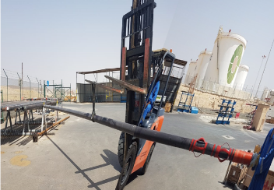
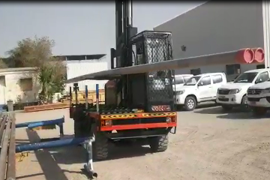
PDO Second Alert
Date: 27th June 2019 Incident title: LTI
What happened?
Whilst reversing the tubing sub assembly, suspended by a web sling under a single fork on the forklift. One end of the assembly has struck a pipe rack causing the assembly to slip in the sling and the opposite end to drop to the ground landing on the technicians foot.
Your learning from this incident.
Always fully comply with the approved lift plan.
Hands Off Tools to be used during the lifting activities.
Always intervene for any unsafe action
Only lift when the lifting supervisor is present
Always use the 10 questions for a safe lift
Use proper lifting method
Notes:
Ensure all dates and titles are input
A short description should be provided without mentioning names of contractors or individuals. You should include, what happened, to who (by job title) and what injuries this resulted in. Nothing more!
Four to five bullet points highlighting the main findings from the investigation. Remember the target audience is the front line staff so this should be written in simple terms in a way that everyone can understand.
The strap line should be the main point you want to get across
The images should be self explanatory, what went wrong (if you create a reconstruction please ensure you do not put people at risk) and below how it should be done.

Slide 2
Management self audit
Date: 27th June 2019 Incident title: LTI
As a learning from this incident and ensure continual improvement all contract
managers must review their HSE HEMP against the questions asked below
Confirm the following:
Do you ensure that all staff are using the correct lifting equipment
Do you ensure lifting plans are approved by a competent person?
Do you ensure that your empowerment to stop culture effective?
Do you ensure all staff are learning from previous incidents?
Do you ensure all Risk Normalization are identified and compliance?
* If the answer is NO to any of the above questions please ensure you take action to correct this finding.
Notes:
Ensure all dates and titles are input
Make a list of closed questions (only ‘yes’ or ‘no’ as an answer) to ask others if they have the same issues based on the management or HSE-MS failings or shortfalls identified in the investigation.
Imagine you have to audit other companies to see if they could have the same issues.
These questions should start with: Do you ensure…………………?

