Slide 1
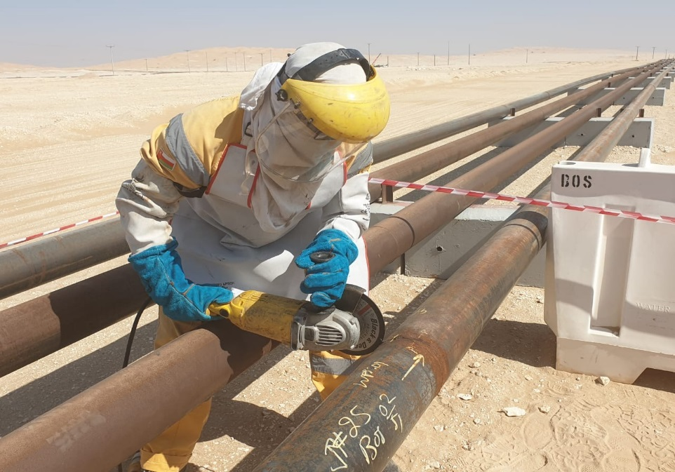
Safety Alert
Use this Alert: Discuss in Tool Box Talks and HSE Meetings ➔ Distribute to contractors ➔ Post on HSE Notice Boards ➔ Include in site HSE Induction
Targeted audience: Construction, Engineering, Drilling, Operations & Logistics
Cutting & welding live flow line (21st February , 2020)
What happened?
The job was to repair a welding joint flow line, while the crew was instructed to start the job and PTW was issued, instead of going to the correct location, they went to the wrong flow line and started grinding. After realizing that the flow line was live, they decided to weld it instead of stop and report.
Similar Incident: Cutting live flow line (1st February, 2015)
What happened?
The crew was mobilized to continue the dismantling of the remaining section of the redundant flow line that was partially completed in previous days. The work started after the morning Tool Box Talk when the fitter placed the cold cutter on the wrong / pressurized section of the newly replaced flow line and started cutting the line. Immediately, a member of the second crew intervened to STOP the activity when he realized the cutter had been placed on the wrong flow line.
Video Link:
PDO: Click here
Contractors: Click here
Learning:
Always ensure Permit Applicant, Holder and Responsible Supervisor visit the site prior to issue/acceptance of the permit.
Always ensure that pipes are marked at the cutting spot.
Always confirm with your PTWH that you are cutting the right pipe.
Always ensure marking for cutting is discussed and understood by all during TBT.
“This document is restricted and it is distributed for information purposes only and it shall not be shared with other than PDO employees and contracts without PDO permission”.

