Slide 1
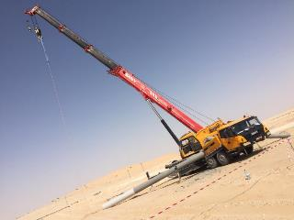

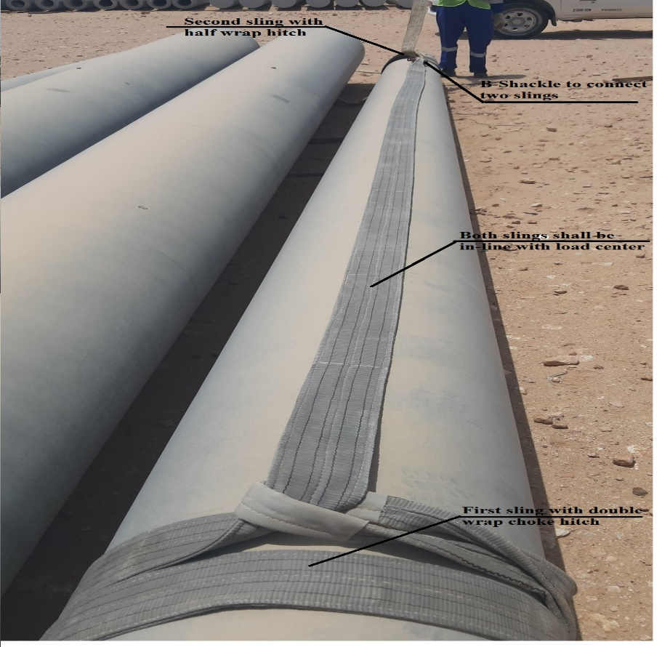
PDO Second Alert
Date: 24.04.2019 Incident title: Hipo# 31, OHL lifting incident
What happened?
ATE Sub contractor electrical crew was engaged in guard pole erection at Hawqa 23 road crossing location. The crane operator raised the pole into the vertical position. While attempting to lift the guard pole, the round endless sling failed to grip the pole and the sling slipped off. The concrete pole toppled onto the crane at the rear side of the driver cabin.
Your learning from this incident..
Always ensure approved lifting plan is available before commencement of lifting activity.
Always ensure that correct rigging method is used for lifting.
Always ensure right equipment are in place before commencement of task..
Always ensure proper communication and coordination between AP, PA and crew members.
Ensure correct rigging method and proper equipment used for lifting activity
Notes:
Ensure all dates and titles are input
A short description should be provided without mentioning names of contractors or individuals. You should include, what happened, to who (by job title) and what injuries this resulted in. Nothing more!
Four to five bullet points highlighting the main findings from the investigation. Remember the target audience is the front line staff so this should be written in simple terms in a way that everyone can understand.
The strap line should be the main point you want to get across
The images should be self explanatory, what went wrong (if you create a reconstruction please ensure you do not put people at risk) and below how it should be done.

Slide 2
Management self audit
Date: 24.04.2019 Incident title: Incident title: Hipo# 31, OHL lifting incident
As a learning from this incident and ensure continual improvement all contract
managers must review their HSE HEMP against the questions asked below
Confirm the following:
Do you ensure that appropriate lifting plan is attached along with PTW?
Do you ensure the Rigging method used is correct as per procedure?
Do your supervisor visits site before applying the permit to see the site conditions?
Do your Supervisor explain about PTW requirements with appropriate control measures to crew at site?
Do you ensure that Sub contractor management is appropriate at site?
* If the answer is NO to any of the above questions please ensure you take action to correct this finding.
Notes:
Ensure all dates and titles are input
Make a list of closed questions (only ‘yes’ or ‘no’ as an answer) to ask others if they have the same issues based on the management or HSE-MS failings or shortfalls identified in the investigation.
Imagine you have to audit other companies to see if they could have the same issues.
These questions should start with: Do you ensure…………………?

