Slide 1
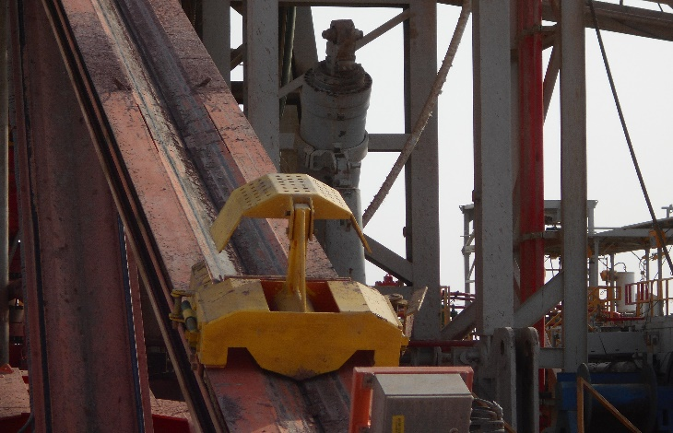
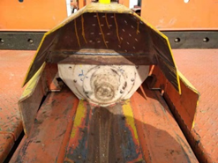
PDO Second Alert
Date: 20.07.2019 Incident title: Drill pipe fell
What happened?
Around 01:04 am,20.July 2019, Rig 111 was laying down 4” drill pipe. One of the singles was put into the power catwalk groove. Then, the driller coach lowered the travelling block until the DP lay in the groove of the trough, and open the elevator and continued lowering down the elevator. But the DP was still hung on the elevator with the residual contacting half inside elevator, which caused the DP box end continue to be lowered and the pin end of DP raised. When lowering the elevator, the friction force suddenly released, and the pin end of the DP rested on the back board of power catwalk and slipped down through the gap between the power catwalk skate cap and top of back board and dropped to the pipe rack area.
Your learning from this incident.
The power catwalk skate design need to be reviewed and FMEA shall be developed cause this is critical as reference for SOP, HEMP and JSA.
The HEMP, SOP and JSA must cover all the associated risks and relevant controls shall be in place.
The driller must confirm that the DP is fully disengage from the elevator before lowering down and to use the skate to free the DP in case required.
Gap on the skate
Leave no gap after modification
Do not stand in No-Go Zone!
Notes:
Ensure all dates and titles are input
A short description should be provided without mentioning names of contractors or individuals. You should include, what happened, to who (by job title) and what injuries this resulted in. Nothing more!
Four to five bullet points highlighting the main findings from the investigation. Remember the target audience is the front line staff so this should be written in simple terms in a way that everyone can understand.
The strap line should be the main point you want to get across
The images should be self explanatory, what went wrong (if you create a reconstruction please ensure you do not put people at risk) and below how it should be done.

Slide 2
Management self audit
Date: 20th July 2019
Incident title: Drill pipe fell
As a learning from this incident and ensure continual improvement all contract
managers must review their HSE HEMP against the questions asked below
Confirm the following:
Do you ensure your HEMP/SOP/JSA are regularly reviewed?
Do you ensure that your rig equipment has no design deficiency?
Do you ensure that your HSE audit, inspection, reviews are taking place and documented with findings and remedial actions taken?
Do you ensure that you have competent resource to conduct HEMPs or to review existing HEMPs?
Do you ensure that there is a system in place to implement learning from incidents?
Do you ensure power catwalk skate hood is well designed to fit for tubular diameter to prevent drop before start of operation?
* If the answer is NO to any of the above questions please ensure you take action to correct this finding.
Notes:
Ensure all dates and titles are input
Make a list of closed questions (only ‘yes’ or ‘no’ as an answer) to ask others if they have the same issues based on the management or HSE-MS failings or shortfalls identified in the investigation.
Imagine you have to audit other companies to see if they could have the same issues.
These questions should start with: Do you ensure…………………?

