Slide 1
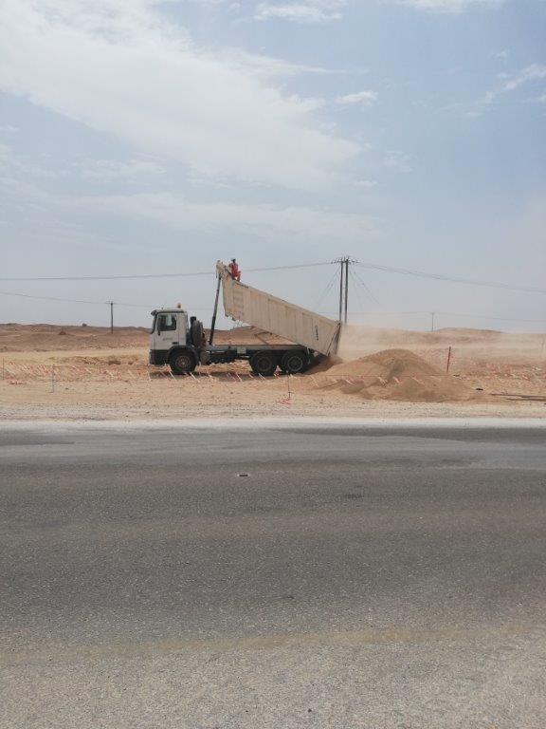
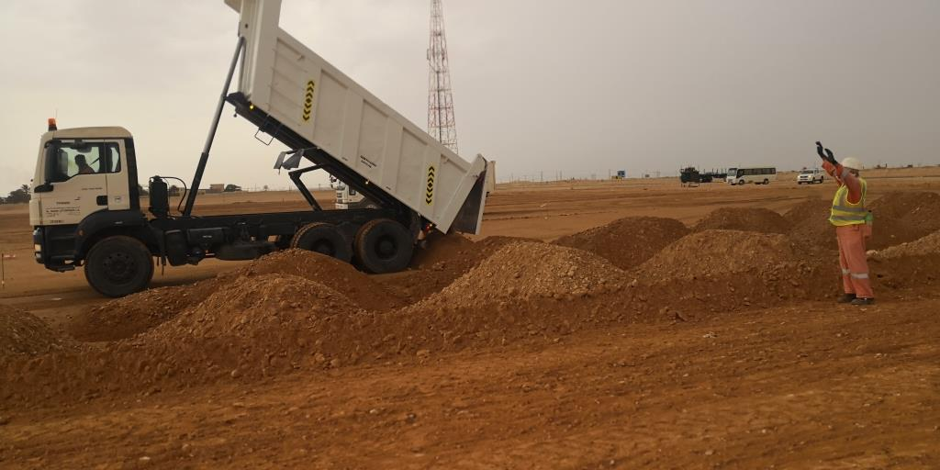
PDO Second Alert
Date: 23.07.2019 Incident title : HIPO# 48, Near miss
What happened?
The helper ascended the tipper from left side inbuilt ladder and walked towards rear right side of the tipper hopper to untie the green net cover. While helper was moving towards rear left side, he realised that the tipper hopper is being raised. Hence he moved towards front side of the hopper by holding the side board and tried to alert the driver by shouting. Meanwhile QC Inspector, working nearby observed the helper and immediately alerted the driver.
Your learning from this incident..
Always ensure effective supervision during tipper loading/off loading operations
Always ensure trained banksman is available for signalling
Always ensure all activities as per daily work plan is covered in TBT
Always ensure driver is outside the vehicle when banksman is engaged in covering/uncovering the net.
Always ensure unloading of Tipper done only with guidance from Banksman
Notes:
Ensure all dates and titles are input
A short description should be provided without mentioning names of contractors or individuals. You should include, what happened, to who (by job title) and what injuries this resulted in. Nothing more!
Four to five bullet points highlighting the main findings from the investigation. Remember the target audience is the front line staff so this should be written in simple terms in a way that everyone can understand.
The strap line should be the main point you want to get across
The images should be self explanatory, what went wrong (if you create a reconstruction please ensure you do not put people at risk) and below how it should be done.

Slide 2
Management self audit
Date: 23.07.2019 Incident title : Hipo# 48, Near miss
As a learning from this incident and ensure continual improvement all contract
managers must review their HSE HEMP against the questions asked below
Confirm the following:
Do you ensure that your employees adopt safe work methodology and avoid taking shortcuts?
Do you ensure that work is planned with adequate resources required for the activity?
3. Do you ensure that trained and competent personnel are deployed to carry out activity?
* If the answer is NO to any of the above questions please ensure you take action to correct this finding.
Notes:
Ensure all dates and titles are input
Make a list of closed questions (only ‘yes’ or ‘no’ as an answer) to ask others if they have the same issues based on the management or HSE-MS failings or shortfalls identified in the investigation.
Imagine you have to audit other companies to see if they could have the same issues.
These questions should start with: Do you ensure…………………?

