Slide 1
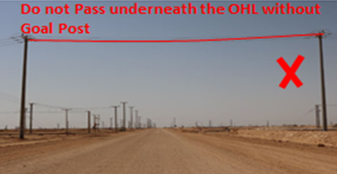
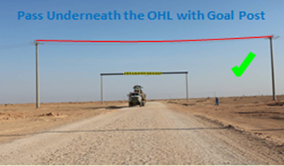
PDO Second Alert
Date: 24.08.2019 HiPo - Prime Mover with Brine Tank Load Contacts OHL
What happened?
During Rig 102 infield Move from IHSAN to ALBURJ (14.7 km) . Post finishing TBT, brine tank was loaded on the winch truck trailer. After loading, the driver decided to follow the Oilfield proceeding to New Location The Oilfield truck took a left turn deviating from the surveyed route, the Brine Tank driver following him proceeded in the same route and after advancing approx. 200 meters from the deviated turn, the pole light on top of the Brine Tank contacted the 33 kV Over Head Power Line (9.0 meters high) entangling it and dragging the power line for 30 meters resulting in the breakage of 5 supporting wooden utility poles. No Injury to driver.
Your learning from this incident..
Deviating from your route can lead to unforeseen hazards
Always travel on the surveyed route and No deviation from the rig move surveyed route.
Do not access route having power lines without goal posts and safety barriers.
Follow convoy procedures.
Learning points for them from the investigation
Ensure you drivers follow the route survey through IVMS system
Ensure any deviation from procedures are recorded and properly reviewed
Warning Signage must be installed for road users alertness.
OHL must be maintained to the standard height for all road crossing.
Do not pass underneath the OHL without Goal Post.
Notes:
Ensure all dates and titles are input
A short description should be provided without mentioning names of contractors or individuals. You should include, what happened, to who (by job title) and what injuries this resulted in. Nothing more!
Four to five bullet points highlighting the main findings from the investigation. Remember the target audience is the front line staff so this should be written in simple terms in a way that everyone can understand.
The strap line should be the main point you want to get across
The images should be self explanatory, what went wrong (if you create a reconstruction please ensure you do not put people at risk) and below how it should be done.

Slide 2
Management self audit
Date: 24.08.2019 Incident title: HiPo - Prime Mover with Brine Tank Load Contacts OHL
As a learning from this incident and ensure continual improvement all contract
managers must review their HSE HEMP against the questions asked below
Confirm the following:
Do you ensure the Rig move team are following the route survey.
Do you ensure the IVMS for route deviation in After Action Review?
Do you ensure supervisors move oversized load in convoy?
Do you ensure IVMS for route compliance for Rig move?
Do you ensure a robust system to control deviation from the approved route?
Do you ensure all hazards are included in risk assessments and TBT’s?
* If the answer is NO to any of the above questions please ensure you take action to correct this finding.
Notes:
Ensure all dates and titles are input
Make a list of closed questions (only ‘yes’ or ‘no’ as an answer) to ask others if they have the same issues based on the management or HSE-MS failings or shortfalls identified in the investigation.
Imagine you have to audit other companies to see if they could have the same issues.
These questions should start with: Do you ensure…………………?

