Slide 1
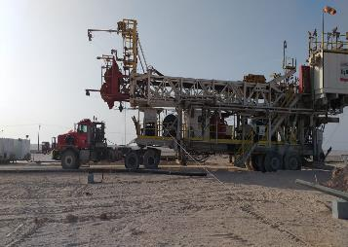

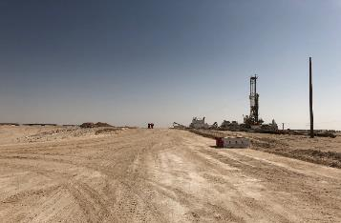
PDO Second Alert
Date: 27.08.19 Incident title HiPo # 51 OHPL Strike.
What happened?
Whilst on route to the new location during a Rig convoy move, at approximately 2000hrs the Rig mast was passing underneath an OHPL 150m from the new location when the Rig mast became entangled with the OHPL causing it to snap 3 x lines and 3 x OHPL Poles. The driver stopped the vehicle on being alerted of the incident. The RMS then made the decision for the driver to remain in the vehicle until the area was barricaded and that no electrical power existed before the driver was instructed to exit from the vehicle. No injuries were sustained
Your learning from this incident..
RMS / ARMS
Ensure you record ALL hazards on route on the route survey
Ensure you brief all other participating ARMS, RMS and drivers on the route survey
Ensure all ARMS, RMS and Drivers have a coloured copy of the route survey
Ensure you plan ahead to avoid driving in the dark
RMS / ARMS / Drivers and others
Ensure you report any discrepancies or changes with the route survey
Ensure you have a colored copy of the route survey
Ensure you have been briefed on the route survey
Ensure you use your empowerment to STOP where required
Avoid driving in the dark
Ensure all OHPL are identified on route surveys
Use your empowerment to stop unsafe acts
Notes:
Ensure all dates and titles are input
A short description should be provided without mentioning names of contractors or individuals. You should include, what happened, to who (by job title) and what injuries this resulted in. Nothing more!
Four to five bullet points highlighting the main findings from the investigation. Remember the target audience is the front line staff so this should be written in simple terms in a way that everyone can understand.
The strap line should be the main point you want to get across
The images should be self explanatory, what went wrong (if you create a reconstruction please ensure you do not put people at risk) and below how it should be done.

Slide 2
Management self audit
Date: 27.08.19 Incident title HiPo # 51 OHPL Strike.
As a learning from this incident and ensure continual improvement all contract
managers must review their HSE HEMP against the questions asked below
Confirm the following:
Do you ensure that all persons conducting route surveys have received adequate training and are competency assessed?
Do you ensure the standards of route surveys by conducting verification checks?
Do you ensure planning take’s into consideration possible delays and how to react to delays?
Do you ensure the DSV or Tool Pusher are present during Route Surveys?
Do you ensure all personnel are aware of the Empowerment to Stop the Work?
Do you ensure all personnel are aware of intervention for unsafe practices?
* If the answer is NO to any of the above questions please ensure you take action to correct this finding.
Notes:
Ensure all dates and titles are input
Make a list of closed questions (only ‘yes’ or ‘no’ as an answer) to ask others if they have the same issues based on the management or HSE-MS failings or shortfalls identified in the investigation.
Imagine you have to audit other companies to see if they could have the same issues.
These questions should start with: Do you ensure…………………?

