Slide 1
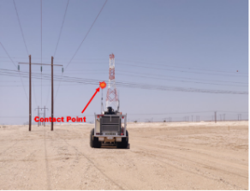
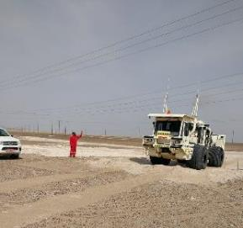
PDO Second Alert
Date: 14th August 2019 Incident title: HiPo Asset Damage
What happened?
On 14th August 2019 at 13:48 a seismic vibrator was detouring between working area near the Fahud Power Station, while crossing underneath a low power line from an unauthorized crossing point (Middle of power line span and without any crossing point marking), vibrator antenna came into contact with a 33kV power line. No injury was sustained by the vibrator driver, only the antennas were damaged on the vibrator, there was no physical damage to the power line.
Your learning from this incident..
Always cross from the designated crossing points
Make sure all the OHL where work is going to take place are identified and marked
Make sure all the HSE controls identified in RAR are addressed and communicated in detail.
Always pay attention to the surrounding while working
In-field supervision should be in place to manage working closer to OHL
Always report incidents/near miss immediately.
Always ensure you know your route, if in doubt STOP and ask
Always follow the working procedures and do not take Shortcuts
Notes:
Ensure all dates and titles are input
A short description should be provided without mentioning names of contractors or individuals. You should include, what happened, to who (by job title) and what injuries this resulted in. Nothing more!
Four to five bullet points highlighting the main findings from the investigation. Remember the target audience is the front line staff so this should be written in simple terms in a way that everyone can understand.
The strap line should be the main point you want to get across
The images should be self explanatory, what went wrong (if you create a reconstruction please ensure you do not put people at risk) and below how it should be done.

Slide 2
Management self audit
Date: 14th August 2019 Incident title: HiPo Asset Damage
As a learning from this incident and ensure continual improvement all contract
managers must review their HSE RAR against the questions asked below
Confirm the following:
Do you ensure all drivers are trained and experienced?
Do you ensure all low power lines are marked and identified?
Do you ensure that all the controls identified in RAR are addressed and communicated in detail.
Do you ensure all drivers are supervised all the time in high risk areas?
Do you ensure that all points are off set from the low powerlines?
Do you ensure all personnel understand the incident reporting protocol regardless of damage?
* If the answer is NO to any of the above questions please ensure you take action to correct this finding.
Notes:
Ensure all dates and titles are input
Make a list of closed questions (only ‘yes’ or ‘no’ as an answer) to ask others if they have the same issues based on the management or HSE-MS failings or shortfalls identified in the investigation.
Imagine you have to audit other companies to see if they could have the same issues.
These questions should start with: Do you ensure…………………?

