Slide 1
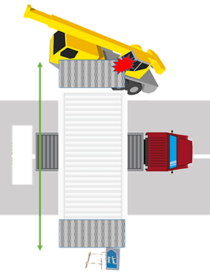
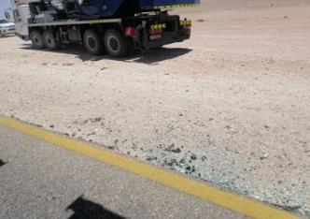
PDO Second Alert
Date:22.09.2019 Incident title: MVI
What happened?
On 22nd September 2019 at 10:30 hours, during rig move from Reihan North 2 to Tabrir South 2, rig was moving on the black top in a convoy with police escort. Police noticed 25 ton crane is coming from the opposite direction and alerted the crane driver to move away from convoy and wide loads. Crane driver moved approximately 2 meters away from black top resulting in the wide load to collide with the crane operator’s cabin.
There were no Injuries.
Your learning from this incident..
Always respect warning from wide load escort supervisor and ROP
Always Pull over as far as safely possible when approaching wide loads
Lead Supervisor to inform rear escort vehicle to confirm that on coming vehicle have moved to safe distance
✗
Maintain safe distance
Always intervene and stop the convoy if there are obstacles on the road
Notes:
Ensure all dates and titles are input
A short description should be provided without mentioning names of contractors or individuals. You should include, what happened, to who (by job title) and what injuries this resulted in. Nothing more!
Four to five bullet points highlighting the main findings from the investigation. Remember the target audience is the front line staff so this should be written in simple terms in a way that everyone can understand.
The strap line should be the main point you want to get across
The images should be self explanatory, what went wrong (if you create a reconstruction please ensure you do not put people at risk) and below how it should be done.

Slide 2
Management self audit
Date: 22.09.2019 Incident title: MVI
As a learning from this incident and to ensure continual improvement all contractors must review their Rig move convoy procedures against the questions asked below :
Confirm the following:
Do you ensure learning from incidents are reaching end users?
Do you ensure your drivers / operators are aware of wide load hazards?
Do you ensure the logistics companies have clear plan to deal with dynamics situations?
Do you ensure that rig move observations are carried out and findings shared with contractors?
* If the answer is NO to any of the above questions please ensure you take action to correct this finding.
Notes:
Ensure all dates and titles are input
Make a list of closed questions (only ‘yes’ or ‘no’ as an answer) to ask others if they have the same issues based on the management or HSE-MS failings or shortfalls identified in the investigation.
Imagine you have to audit other companies to see if they could have the same issues.
These questions should start with: Do you ensure…………………?

