Slide 1
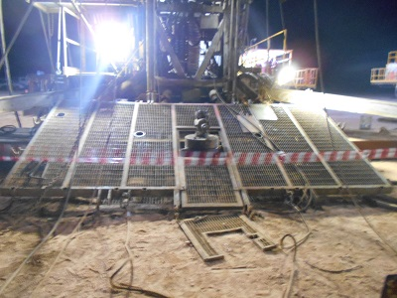
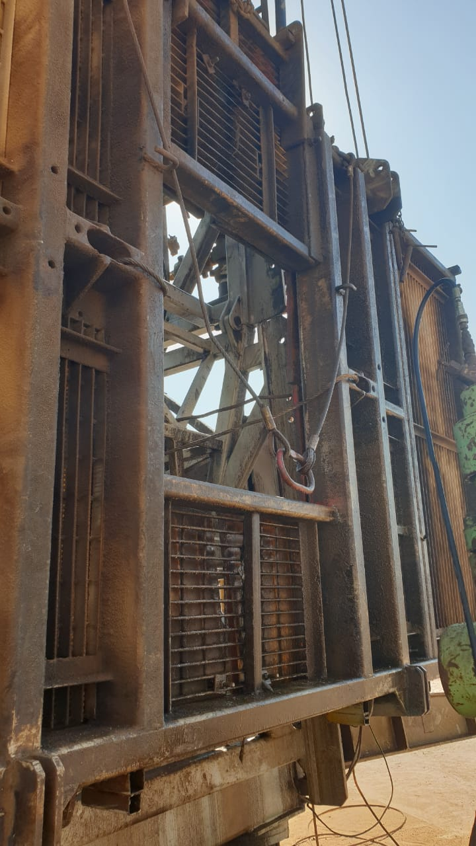
PDO Second Alert
Date: 2nd October 2019 Incident title: HiPo#58 Drops
What happened?
After rig up the Hoist, the driller observed the block not in the centre to the well. Therefore, the crew decided to rig down the Hoist and adjust it again. While scooping down the upper section of the mast, the traveling block links hit the working platform and broke the safety clamp which was holding the folded working platform. As a result, the working platform dropped from one end and hit the well head.
Your learning from this incident.
Always use wire rope sling with shackle instead of using uncertified clamp to fasten the Hoist floor
Always include folded Working platform in the DROP survey and checklist.
Always follow OEM recommendation.
To be provided
Ensure secondary retention for working platforms prior to the move.
Notes:
Ensure all dates and titles are input
A short description should be provided without mentioning names of contractors or individuals. You should include, what happened, to who (by job title) and what injuries this resulted in. Nothing more!
Four to five bullet points highlighting the main findings from the investigation. Remember the target audience is the front line staff so this should be written in simple terms in a way that everyone can understand.
The strap line should be the main point you want to get across
The images should be self explanatory, what went wrong (if you create a reconstruction please ensure you do not put people at risk) and below how it should be done.

Slide 2
Management self audit
Date: 2nd October 2019 Incident title: HiPo#58 Drops
As a learning from this incident and ensure continual improvement all contract
managers must review their HSE HEMP against the questions asked below
Confirm the following:
Do you ensure that DROPS 3rd Party inspection are carried out in various phases of operations?
Do you ensure that the visibility factor (control panel – travelling block) is addressed during the design stage.
Do you ensure that awareness sessions are carried out with the employees on infrequent activities, related hazards and control measures?
Do you ensure that locally manufactured items without certificates are not used?
Do you ensure that MoC is raised prior to changing the OEM approved equipment?
* If the answer is NO to any of the above questions please ensure you take action to correct this finding.
Notes:
Ensure all dates and titles are input
Make a list of closed questions (only ‘yes’ or ‘no’ as an answer) to ask others if they have the same issues based on the management or HSE-MS failings or shortfalls identified in the investigation.
Imagine you have to audit other companies to see if they could have the same issues.
These questions should start with: Do you ensure…………………?

