Slide 1
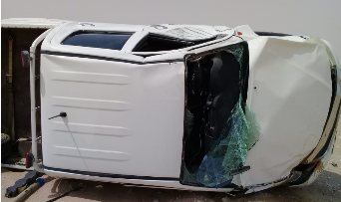
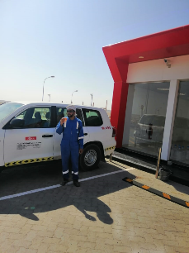
PDO Second Alert
Main contractor name – LTI# - Date of incident
Date: 5th October 2019 Incident: HiPo#59 MVI
What happened?
While driving on the highway continuously for 3h, from Fahud to Marmul (639 km), the driver got drowsy which resulted in the vehicle drifting and hitting the barrier on the right side of the road.
The driver sharply oversteered the vehicle to the left side in attempt to rectify the situation prior to the passenger side front tire puncturing. This has caused the driver to further lose control over the vehicle and drift off-road beyond the black top resulting in the vehicle rolling over.
Your learning from this incident.
Every two (2) hours of continuous driving, stop and have minimum 15 minutes of rest
Stop for a rest in nearest safe area at any time if you feel drowsy
When travelling for long distances consider alternative methods of transport such as flying
Apply defensive driving techniques while driving at all times
Wearing a seat belt drastically reduces your chance of injury if an accident occurs
2 hours of driving?
Stop for 15 minutes rest!
Notes:
Updated as per PDO comments

Slide 2
Management self audit
Date: 5th October 2019 Incident: HiPo#59 MVI
As a learning from this incident and ensure continual improvement all contract managers must review their HSE HEMP against the questions asked below
Confirm the following:
Do you ensure your journey management covers the requirements of stopping after 2 hours driving?
Do you ensure that your competency requirements for journey creators covers the skills to perform a full risk assessment for long trips?
Do you ensure that your transportation vendors/contractors audit assess the level of quality of their defensive driving training/ Fatigue Management and Risk Assessment?
Do you ensure you include journey management health check during assurance audits?
Do you ensure your journey management processes are compliant with SP2000?
Do you ensure journeys over 200km have management approval?
* If the answer is NO to any of the above questions please ensure you take action to correct this finding.
Notes:
Slide updated with PDO requested confirmations with each question to begin with language “Do you ensure…”

