Slide 1
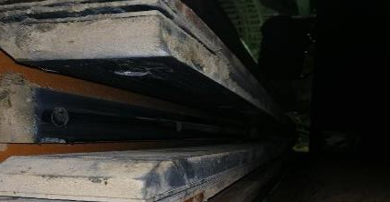
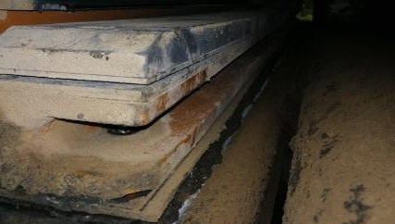
PDO Second Alert
Date: 3rd October 2019 Incident: HiPo#60 DROPS
What happened?
On 3rd Oct 2019 At around 16:03 Hrs. the operation was retrieving the source from rig floor, after retrieving down R/A source from the Rig floor the MWD personnel moved out of the red zone. Suddenly one of the TDS dolly liner from (off drillers side) dropped inside the red zone from approximately 5m height and landed next to the racking back area off the driller side. At the time no personnel were in the red zone.
Learning from this incident..
Ensure to replace all TDS dolly liners with upgraded model from OEM and ensure secondary retention is installed.
Ensure polyethylene TDS dolly liner needs to be added in the Drops Inspection book in order to inspect the same during every weekly drops inspection at location
Look close for DROPs
Notes:
Ensure all dates and titles are input
A short description should be provided without mentioning names of contractors or individuals. You should include, what happened, to who (by job title) and what injuries this resulted in. Nothing more!
Four to five bullet points highlighting the main findings from the investigation. Remember the target audience is the front line staff so this should be written in simple terms in a way that everyone can understand.
The strap line should be the main point you want to get across
The images should be self explanatory, what went wrong (if you create a reconstruction please ensure you do not put people at risk) and below how it should be done.

Slide 2
Management self audit
Date: 3rd October 2019 Incident title HIPO DROPS
As a learning from this incident and ensure continual improvement all contract
managers must review their HSE HEMP against the questions asked below
Confirm the following:
Do you ensure that the DROPS picture covers all aspects (in detail) of the DROPS inspection.
Do you ensure all personnel who carry out DROPS inspections are aware of their responsibilities.
Do you ensure that all equipment is secure, to ensure that no DROPS incident occurs.
Do you ensure that drop leaders have the required DROPS training.
* If the answer is NO to any of the above questions please ensure you take action to correct this finding.
Notes:
Ensure all dates and titles are input
Make a list of closed questions (only ‘yes’ or ‘no’ as an answer) to ask others if they have the same issues based on the management or HSE-MS failings or shortfalls identified in the investigation.
Imagine you have to audit other companies to see if they could have the same issues.
These questions should start with: Do you ensure…………………?

