Slide 1
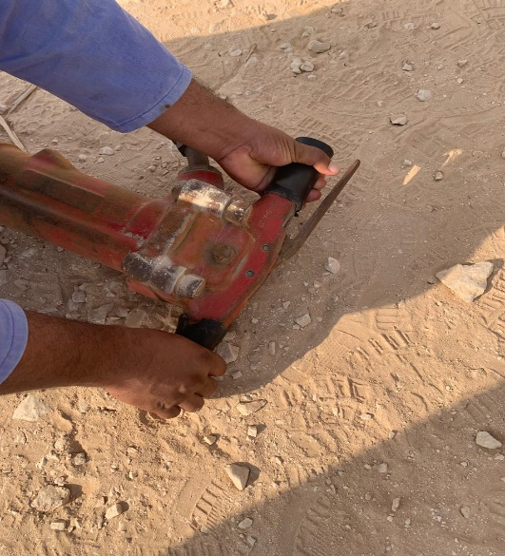
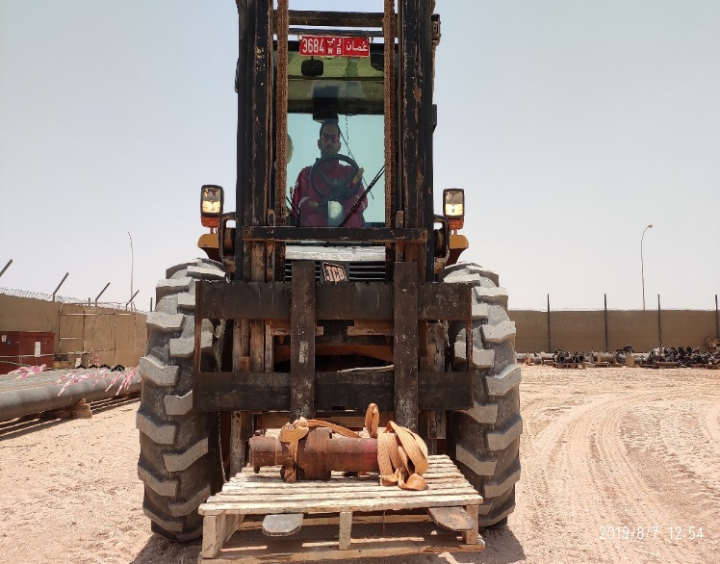
PDO Second Alert
Date: 09th July 2019 Incident title: LTI (Crush Injury)
What happened?
A subcontractor’s Jack Hammer Operator was manually shifting the heavy (43 Kg) jack hammer on his shoulder for Function test to be carried out at the Testing yard. While lowering the jack hammer, Operator’s left hand got crushed between the handle and the floor resulting in a crush injury. After administering first aid, the employee was shifted to Salalah for further treatment where fracture was diagnosed to his metacarpal area. The area Supervisor failed to intervene the unsafe act carried out by the employee without using hand gloves.
Your learning from this incident..
Always follow safe material handling practice.
Always wear PPEs fit for the task.
Always intervene to stop unsafe acts.
Always keep your body parts away from Line of Fire.
Always follow safe material handling practice.
Notes:
Ensure all dates and titles are input
A short description should be provided without mentioning names of contractors or individuals. You should include, what happened, to who (by job title) and what injuries this resulted in. Nothing more!
Four to five bullet points highlighting the main findings from the investigation. Remember the target audience is the front line staff so this should be written in simple terms in a way that everyone can understand.
The strap line should be the main point you want to get across
The images should be self explanatory, what went wrong (if you create a reconstruction please ensure you do not put people at risk) and below how it should be done.

Slide 2
Management self audit
Date: 09th July 2019 Incident title: LTI (Crush Injury)
As a learning from this incident and ensure continual improvement all contract
managers must review their HSE HEMP against the questions asked below
Confirm the following:
Do you ensure risks associated during subcontractor mobilization / demobilization are assessed and activities supervised?
Do you encourage subcontractor employees to consult with your team for adopting safe work practices?
Do you ensure employees take active part in spotting unsafe acts and intervene in time?
Do you ensure site visits and inspections focus on compliance to critical safety requirements like – risk assessment, TBT, supervision?
Do you ensure safe work procedures are followed during work execution at all stages especial in peripheral area?
Do you ensure employees are aware about the correct PPEs for the task?
Do you ensure out of site locations are identified and monitored?
* If the answer is NO to any of the above questions please ensure you take action to correct this finding.
Notes:
Ensure all dates and titles are input
Make a list of closed questions (only ‘yes’ or ‘no’ as an answer) to ask others if they have the same issues based on the management or HSE-MS failings or shortfalls identified in the investigation.
Imagine you have to audit other companies to see if they could have the same issues.
These questions should start with: Do you ensure…………………?

