Slide 1
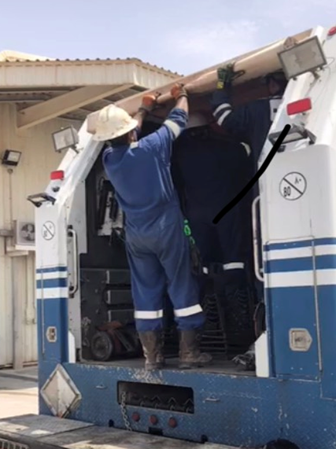
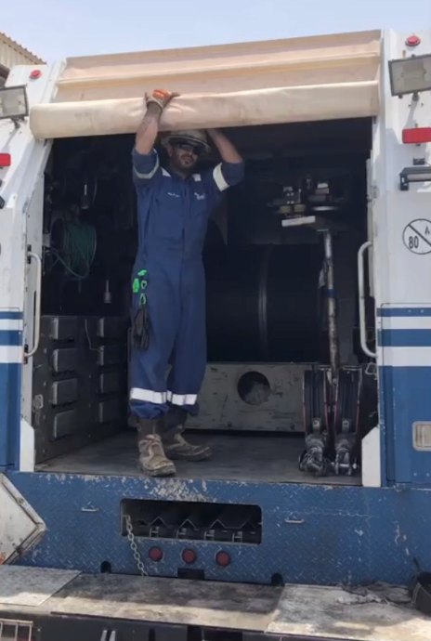
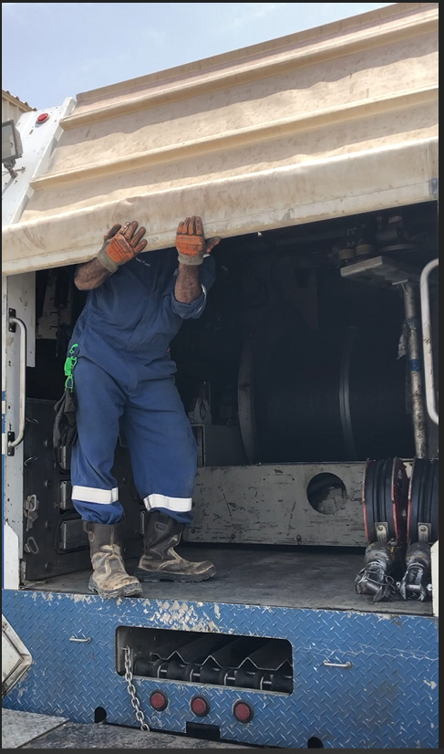
PDO Second Alert
Date: 11.07.19 Incident title: LTI#09 Arm Injury
What happened?
After finalizing the wireline job in ZAH-25H1, wireline crew were packing the equipment and storing in the wireline truck. It was windy and logging senior operator was tried to help his operator colleague to bring down the tarpaulin drum cover, when a strong wind pushed the cover upward resulting loss of balance of Sr. operator and falling on the ground (1.45m). The senior operator sustained a fracture on his right upper arm.
Your learning from this incident..
Always check your position for doing the Job safely
Always coordinate with the crew to provide any support if required
Ensure proper storage of the tools without any tripping hazards
Always discuss all routine tasks and associated hazards with crew before start of operations
Always check Your footing and maintain 3 point contact
Notes:
Ensure all dates and titles are input
A short description should be provided without mentioning names of contractors or individuals. You should include, what happened, to who (by job title) and what injuries this resulted in. Nothing more!
Four to five bullet points highlighting the main findings from the investigation. Remember the target audience is the front line staff so this should be written in simple terms in a way that everyone can understand.
The strap line should be the main point you want to get across
The images should be self explanatory, what went wrong (if you create a reconstruction please ensure you do not put people at risk) and below how it should be done.

Slide 2
Management self audit
Date: 11.07.19 Incident title: LTI#09 Arm Injury
As a learning from this incident and ensure continual improvement all contract
managers must review their HSE HEMP against the questions asked below
Confirm the following:
1. Do you ensure that hazard awareness is understood by all workforce
2. Do you ensure that Stop Work culture is enforced in the workforce
3. Do you ensure that adequate resources of tools and equipment are provided for the operations
Do you Ensure dynamic Hazards considered in Dynamic Risk Assessment
Do you participate in walk through and talk through to identify the routine job hazards and discuss with team
Do your ensure non core job hazards are identified and integrated with the HEMP for the activity.
* If the answer is NO to any of the above questions please ensure you take action to correct this finding.
Notes:
Ensure all dates and titles are input
Make a list of closed questions (only ‘yes’ or ‘no’ as an answer) to ask others if they have the same issues based on the management or HSE-MS failings or shortfalls identified in the investigation.
Imagine you have to audit other companies to see if they could have the same issues.
These questions should start with: Do you ensure…………………?

