Slide 1
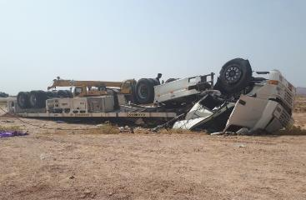
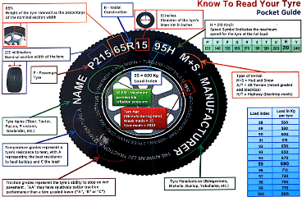
PDO Second Alert
Date: 22/07/2019 Incident title: MVI fatality
What happened?
On the 22nd July 2019 at 1134, a Heavy Goods Vehicle was travelling to Fahud with a load of Glass Reinforced Plastic (GRP) pipes from Sohar, when it was involved in a Motor Vehicle Incident (MVI). The driver was unable to control the vehicle which swerved to the left, over the opposite lane, passing through a Wadi runoff before tipping and rolling over. The driver and 3rd party passenger were fatally wounded as a result of the incident.
Your learning from this incident..
Do you ensure tyre pressures are correct and tyre conditions checked regularly
Do you ensure you conduct daily vehicle inspection before starting your journey
Do you ensure you follow your journey plan
Do you ensure you are adequately rested prior to starting journeys
Do you ensure you follow defensive driver training
Do you ensure that all passengers are authorised by the Safe Journey Manager
Always ensure you check your vehicle and tyres before commencing journeys

Slide 2
Management self audit
Date: 22/07/2019 Incident title: MVI, Fatality
As a learning from this incident and ensure continual improvement all contract
managers must review their HSE HEMP against the questions asked below
Confirm the following:
Do you ensure drivers are adequately rested prior to commencing journeys?
Do you ensure drivers have been briefed to check their vehicle tyre conditions and load security before journeys and during rest stops?
Do you have tyre inflation equipment and pressure gauges available for drivers to utilise?
Do you ensure drivers know how to react in the event of a tyre blow out?
Do you ensure consequence management is conducted for all IVMS and journey management violations as per SP2000?
Do you ensure that all passengers are authorised through your SJM process?
* If the answer is NO to any of the above questions please ensure you take action to correct this finding.
Notes:
Ensure all dates and titles are input
Make a list of closed questions (only ‘yes’ or ‘no’ as an answer) to ask others if they have the same issues based on the management or HSE-MS failings or shortfalls identified in the investigation.
Imagine you have to audit other companies to see if they could have the same issues.
These questions should start with: Do you ensure…………………?

