Slide 1
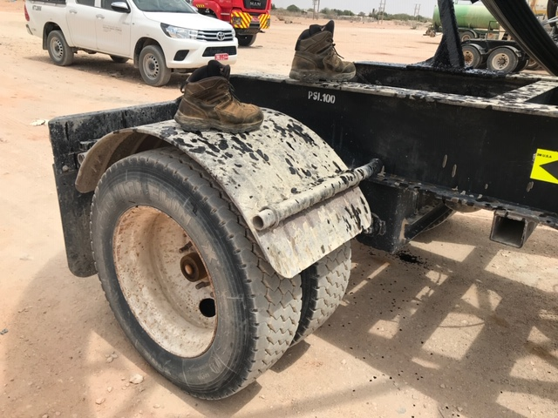
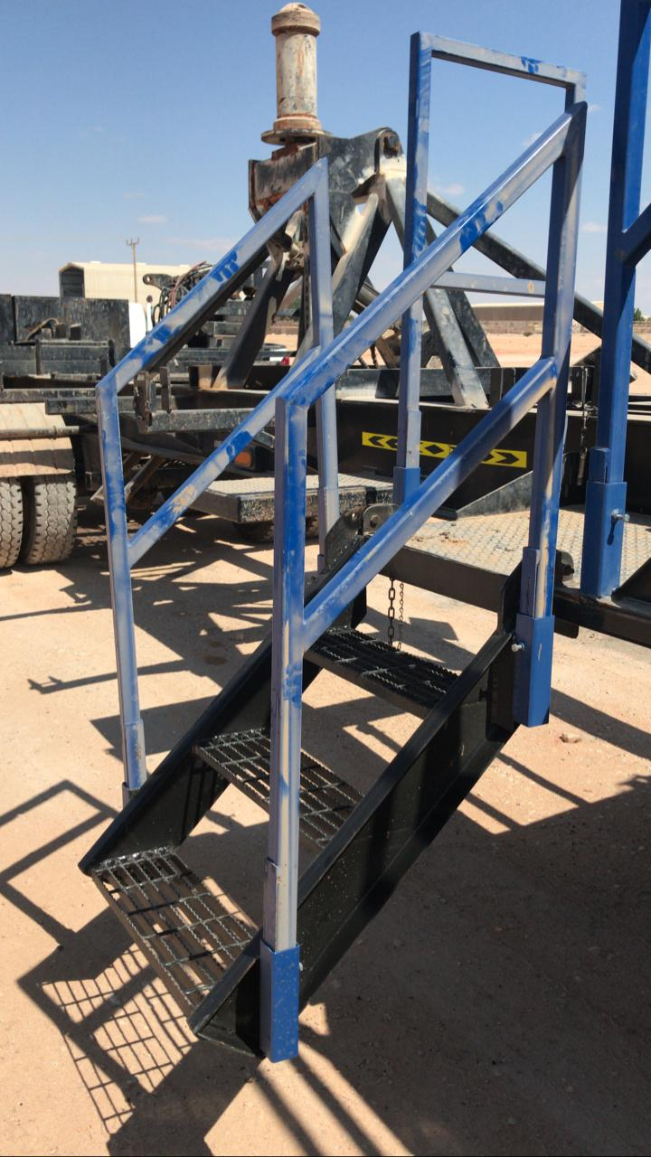
PDO Second Alert
Date: 11/08/19 Incident title: LTI
What happened?
A Banksman was descending from the transport trailer bed area by using the mudguard as support and lost his balance and fell from a height of 1 meter supporting his fall with his right- hand, which resulted in a fracture to his forearm.
Your learning from this incident..
Always avoid going up or down by climbing onto equipment’s/parts that are not designed for it
Always assess the safety of plant and equipment before use and report any missing, unsafe or defective parts to your line supervisor
Always avoid becoming complacent or overconfident to routine tasks
Always ask for guidance or assistance from your supervisor or field HSE Advisor if in doubt
Always ensure that stairs & handrails are available and in safe condition before going up or down an elevated area
Always pay attention to where you are placing your feet.
Make sure 3-point contact is used while going up/down a vehicle/ladder/stairs or any elevated platform
Notes:
Ensure all dates and titles are input
A short description should be provided without mentioning names of contractors or individuals. You should include, what happened, to who (by job title) and what injuries this resulted in. Nothing more!
Four to five bullet points highlighting the main findings from the investigation. Remember the target audience is the front line staff so this should be written in simple terms in a way that everyone can understand.
The strap line should be the main point you want to get across
The images should be self explanatory, what went wrong (if you create a reconstruction please ensure you do not put people at risk) and below how it should be done.

Slide 2
Management self audit
Date: 11/08/19 Incident title: LTI
As a learning from this incident and ensure continual improvement all contract
managers must review their HSE HEMP against the questions asked below
Confirm the following:
Do you ensure that stairway / slips, trips & fall safety awareness is covered during your TBT meetings?
Do you ensure that a slip, trip and fall Hazard hunt checklist is developed and implemented for your operations?
Do you ensure effectiveness of the hazard hunts by constantly reviewing the finding trends and implementing an action plan for rectification?
Do you ensure that stairway / slips, trips & fall Safety is covered in your HEMP?
Do you ensure that stairway / slips, trips & fall safety is part of your JSA’s?
Do you ensure that all plant and equipment go through an acceptance process as per the client standards before putting them in service?
* If the answer is NO to any of the above questions please ensure you take action to correct this finding.
Notes:
Ensure all dates and titles are input
Make a list of closed questions (only ‘yes’ or ‘no’ as an answer) to ask others if they have the same issues based on the management or HSE-MS failings or shortfalls identified in the investigation.
Imagine you have to audit other companies to see if they could have the same issues.
These questions should start with: Do you ensure…………………?

