Slide 1
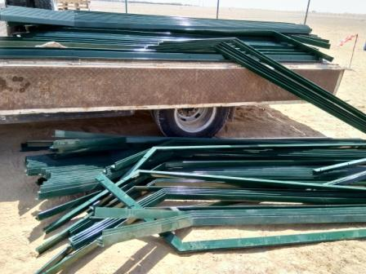
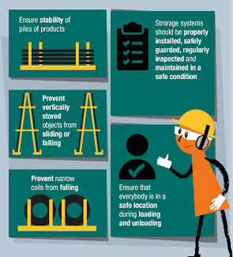
PDO Second Alert
Date: 10.10.2019 Incident title Leg Injury
What happened?
A civil technician suffered fracture on his left leg.
Technician along with a Co-worker, opened the side door to unload fence posts, the posts which were resting on the door dropped down suddenly and hit on his left leg resulting in injury. Technician was immediately referred PAC clinic and later on taken to Nizwa Ministry of Health Hospital.
Your learning from this incident..
Ensure that the materials are properly loaded, stacked and secured prior to transporting / unloading.
Keep away from line of fire; position in such a way as to safely handle the loads.
Supervisor to explore the use of mechanical aids to avoid / minimize manual handling.
Supervisor to discuss the hazards and risks specific to the activity and ensure crew is familiar with the precautions.
Keep away from ‘line of fire’ !!!
Notes:
Ensure all dates and titles are input
A short description should be provided without mentioning names of contractors or individuals. You should include, what happened, to who (by job title) and what injuries this resulted in. Nothing more!
Four to five bullet points highlighting the main findings from the investigation. Remember the target audience is the front line staff so this should be written in simple terms in a way that everyone can understand.
The strap line should be the main point you want to get across
The images should be self explanatory, what went wrong (if you create a reconstruction please ensure you do not put people at risk) and below how it should be done.

Slide 2
Management self audit
Date: 10.10.2019 Incident title Leg Injury
As a learning from this incident and ensure continual improvement all contract
managers must review their HSE HEMP against the questions asked below
Confirm the following:
Does Management ensure that sub contractor supervisors are competent and experienced?
Does contractor Focal point ensure Subcontractors comply to PDO Standards?
Does management site walk cover questionnaire on Lifting activities ?
Does the site management witness and encourage use of 10 point lifting checklist at site?
Do management discuss BBS data and how sites are reporting Near Miss events?
Does Supervisor’s training include roles and responsibilities of Subcontractor Focal point?
* If the answer is NO to any of the above questions please ensure you take action to correct this finding.
Notes:
Ensure all dates and titles are input
Make a list of closed questions (only ‘yes’ or ‘no’ as an answer) to ask others if they have the same issues based on the management or HSE-MS failings or shortfalls identified in the investigation.
Imagine you have to audit other companies to see if they could have the same issues.
These questions should start with: Do you ensure…………………?

