Slide 1
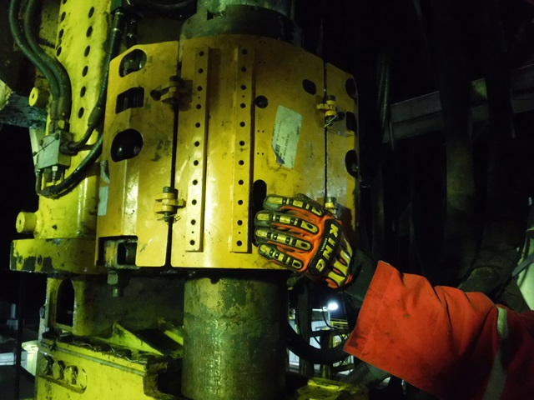
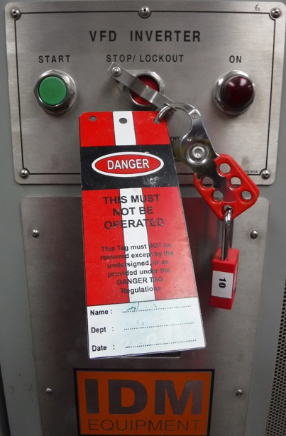
PDO Second Alert
Date:14.10.2019 Incident title : LTI
What happened?
On 14th Oct, 2019 at 19:52 hrs, while floor man was rotating the IBOP (Internal Blow out Preventer) actuator by holding the cover from side opening to install the anti-rotating kit, driller operated the IBOP which caused floor-man left hand’s fingers to be caught in between the cover & actuator resulting crush injuries on his fingers.
Medic administered first aid and patient transferred to Muscat Private Hospital for further management.
.
Your learning from this incident..
Always plan the job adequately and ensure good communication among the workers.
Always stay away from line of fire and highlight the pinch point hazards prior to perform any task.
Always make sure no one is in red zone before operating the equipment.
Always ensure proper isolation (lock out/Tag out) is in place for energized system.
Always ensure complete task discussed and understood by the workers
Wrong hand placement
Always ensure task completed before de-isolation
VFD lock out
Follow LSR
Notes:
Ensure all dates and titles are input
A short description should be provided without mentioning names of contractors or individuals. You should include, what happened, to who (by job title) and what injuries this resulted in. Nothing more!
Four to five bullet points highlighting the main findings from the investigation. Remember the target audience is the front line staff so this should be written in simple terms in a way that everyone can understand.
The strap line should be the main point you want to get across
The images should be self explanatory, what went wrong (if you create a reconstruction please ensure you do not put people at risk) and below how it should be done.

Slide 2
Management self audit
Date:14.10.2019 Incident title: LTI
As a learning from this incident and ensure continual improvement all contract
managers must review their HSE HEMP against the questions asked below
Confirm the following:
Do you assure the understanding and implementation of IBOP procedure
Do you ensure hydraulic guards do not allow pinch points / finger access
Do you ensure that your lock out/Tag out cover full requirements of working on TDS
Do you ensure that crew are familiar with lockout / tag-out requirements
* If the answer is NO to any of the above questions please ensure you take action to correct this finding.
Notes:
Ensure all dates and titles are input
Make a list of closed questions (only ‘yes’ or ‘no’ as an answer) to ask others if they have the same issues based on the management or HSE-MS failings or shortfalls identified in the investigation.
Imagine you have to audit other companies to see if they could have the same issues.
These questions should start with: Do you ensure…………………?

