Slide 1
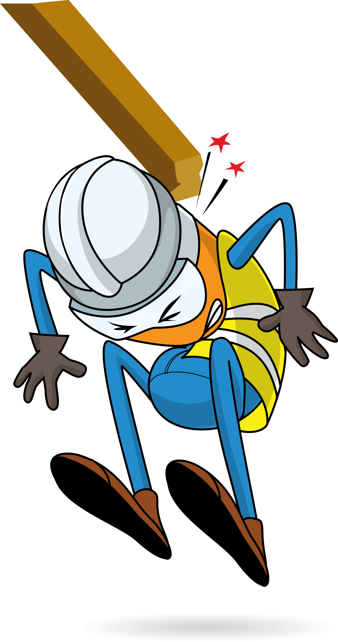
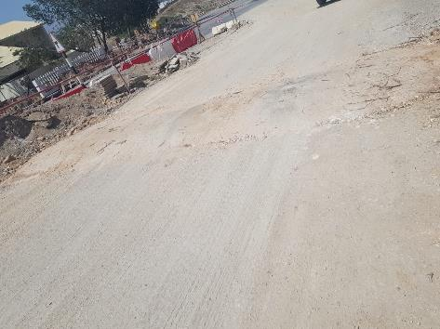
PDO Incident First Alert
Incident Type | LTI#05 | Pattern | Struck By
Date / Time | 01.04.2020@06:00hrs | Directorate
Location | RAH Project | Dept
Target Audience
Construction, Operations, Logistics, Engineering & Drilling
What happened
While travelling to site by bus, when the bus crossed a speed hump, the civil foreman was thrown upwards striking his head on the roof suffering a neck injury.
Mr. Musleh asks the questions of can it happen to you?
Do you ensure all vehicle occupants are wearing seat belts?
Do you intervene with the driver when you feel unsafe?
Do you reduce your speed while crossing speed humps?
Please disseminate this LTI notification to your teams and use it in your tool box talks and HSE meetings and notice boards.

