Slide 1
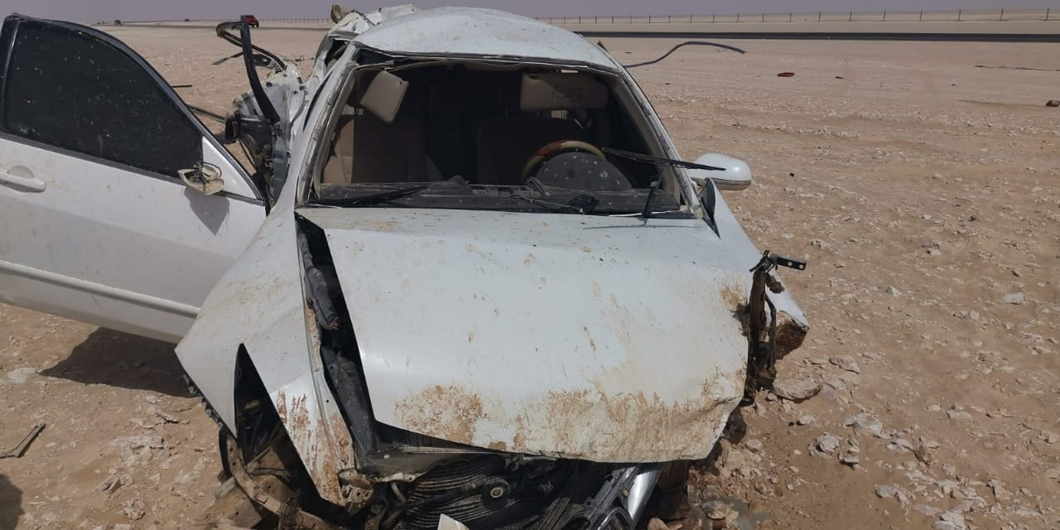
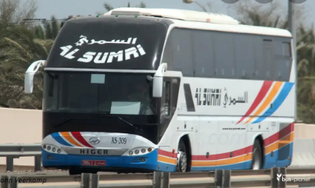
PDO Second Alert
Date: 16th Aug 2019 Incident title: Commuting fatality
What happened?
While commuting alone in a private vehicle from Ibri to Harweel site for his shift. He was driving south towards Haima when the car suddenly went off-road, flipped several times before it stopped causing extensive damage to the vehicle which resulted to his death.
Your learning from this incident..
Always use approved vehicles/bus for journeys.
Avoid using private vehicles
Adjust speed according to the road conditions.
Avoid lone driving when commuting long distance
Take intermittent rest when driving in long journeys
Photo explaining what was done wrong
Photo explaining how it should be done right
Do not take risk. Use Company-provided buses.
Notes:
Ensure all dates and titles are input
A short description should be provided without mentioning names of contractors or individuals. You should include, what happened, to who (by job title) and what injuries this resulted in. Nothing more!
Four to five bullet points highlighting the main findings from the investigation. Remember the target audience is the front line staff so this should be written in simple terms in a way that everyone can understand.
The strap line should be the main point you want to get across
The images should be self explanatory, what went wrong (if you create a reconstruction please ensure you do not put people at risk) and below how it should be done.

Slide 2
Management self audit
Date: 16th Aug 2019 Incident title: Commuting fatality
As a learning from this incident and ensure continual improvement all contract
managers must review their HSE HEMP against the questions asked below
Confirm the following:
Do you ensure that all staff are using commuting services provided?
Do you communicate the risks of private commuting?
Do you have planned actions to promote use of commuting services?
Do you have a system that encourages employees to use commuting services?
Do you have a system to monitor the use of commuting services?
* If the answer is NO to any of the above questions please ensure you take action to correct this finding.
Notes:
Ensure all dates and titles are input
Make a list of closed questions (only ‘yes’ or ‘no’ as an answer) to ask others if they have the same issues based on the management or HSE-MS failings or shortfalls identified in the investigation.
Imagine you have to audit other companies to see if they could have the same issues.
These questions should start with: Do you ensure…………………?

