Slide 1
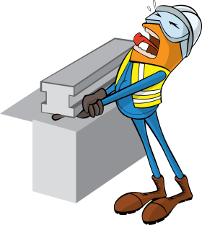
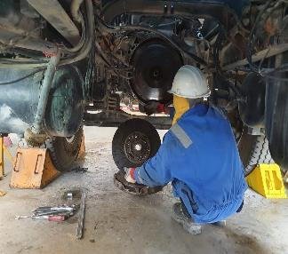
PDO Incident First Alert
Incident Type | LTI#07 | Pattern | Hands & fingers
Date / Time | 22.04.2020@13:45hrs | Directorate
Location | Fahud | Dept
Target Audience
Construction, Operations, Logistics, Engineering , Exploration & Drilling
What happened
While the Mechanic was removing the clutch from a tanker, the clutch disc slipped and fell on his left hand crushing his middle finger.
Mr. Musleh asks the questions of can it happen to you?
How do you ensure you identify all hazards before starting a task?
Do you consider “what could go wrong?”
How do you ensure you handle equipment properly?
How do you ensure your Hands & Fingers are away from ‘Line of Fire’?
Please disseminate this LTI notification to your teams and use it in your tool box talks and HSE meetings and notice boards.

