Slide 1
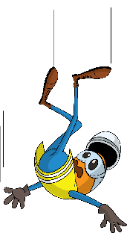
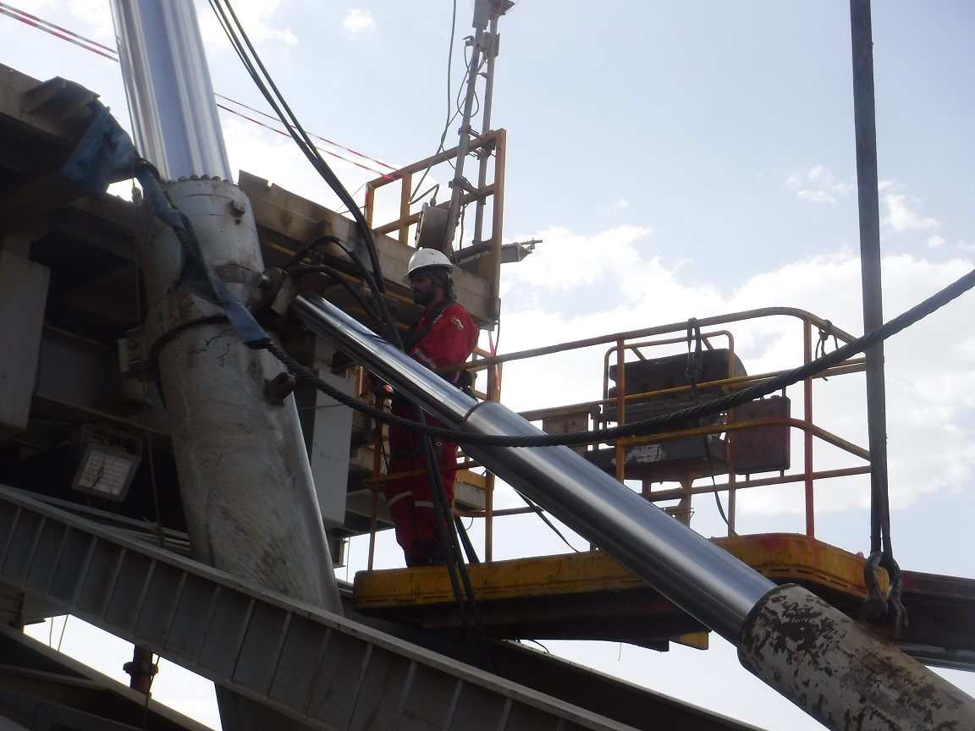
PDO Incident First Alert
Incident Type | LTI#08 | Pattern | Slip , Trip & Fall
Date / Time | 07.05.2020 at 01: 30:00hrs | Directorate
Location | Yibal | Dept
Target Audience
Construction, Operations, Logistics, Engineering , Exploration & Drilling
What happened
Whilst removing a pin between the mast cylinder and support cylinder, the AD was attempting to hammer the pin out, to gain a better position he came out of the cherry picker and fell striking his body on the cross beam fracturing his left rib.
Mr. Musleh asks the questions of can it happen to you?
How do you ensure you identify all hazards before starting a task?
Do you consider “what could go wrong?”
Do you consider if you can fall from height?
Do supervisors ensure staff wear safety harnesses when working at height?
Please disseminate this LTI notification to your teams and use it in your tool box talks and HSE meetings and notice boards.

