Slide 1
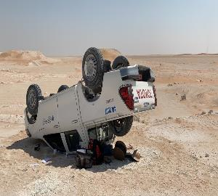
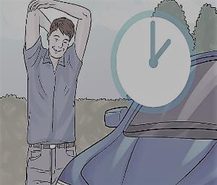
Management self audit
Date: 22nd October 2020 Incident title: HiPo MVI
What happened?
A Service Engineer was driving to a rig from Fahud to attend a routine service call. When he reached Mabrook area, he lost control of the vehicle which lead the vehicle to veer outside the road and rollover, and rest upside down. No injuries resulted to the driver.
Your learning from this incident:
1-Always drive according to the road conditions.
2-Always apply defensive driving techniques while driving.
3-Driver should be committed with speed limits on the graded road.
4-Wearing seatbelt saves lives
Long Trip Take Rest
Always follow the Journey Management Procedure

Slide 2
Date: 22nd October 2020 Incident title: HiPo MVI
Management self audit
As a learning from this incident and ensure continual improvement all contract
managers must review their HSE HEMP against the questions asked below
Confirm the following:
Do you ensure that your staff apply SP2000 within the contract operation?
Do you ensure that you manage above 200 km journeys in order to mitigate the hazards?
Do you ensure compliance with HSE contracts requirement?
Do you ensure staff follow all required trainings?
* If the answer is NO to any of the above questions please ensure you take action to correct this finding.

