Slide 1
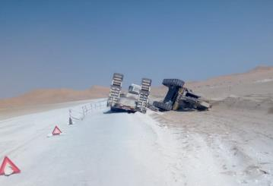
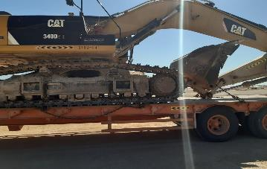
PDO Second Alert
Date: 28th October 2019 Incident title : HiPo #65
What happened?
A low bed driver attempted to stop his vehicle on the side of the road, was not paying full attention to the direction of travel. The low bed passenger side wheels went over the edge of the road and into soft material, causing the vehicle to list to that side, overbalancing the heavy load, which resulted in the load breaking its chains and falling from the trailer landing on its side. No injuries were sustained in this incident.
Your learning from this incident.
Always drive with full attention to the road and the surroundings.
Always ensure safe distance is always maintained from road edges
Always ensure load restraints are in accordance with SP 2001
Always ensure TBTs are dynamic in nature and are inclusive of all supporting activities and updated with any changes to planned activities.
Journey plans to be followed and should include rest and lunch breaks.
Properly secured load
Ensure proper loading at all times !
Tracked excavator on low loader trailer. Two chains are each required at the rear, front and also one to secure the bucket boom.
Notes:
Ensure all dates and titles are input
A short description should be provided without mentioning names of contractors or individuals. You should include, what happened, to who (by job title) and what injuries this resulted in. Nothing more!
Four to five bullet points highlighting the main findings from the investigation. Remember the target audience is the front line staff so this should be written in simple terms in a way that everyone can understand.
The strap line should be the main point you want to get across
The images should be self explanatory, what went wrong (if you create a reconstruction please ensure you do not put people at risk) and below how it should be done.

Slide 2
Management self audit
Date: 28th October 2019 Incident title : HiPo #65
As a learning from this incident and ensure continual improvement all contract
managers must review their HSE HEMP against the questions asked below
Confirm the following:
Do you ensure that journey manager is briefed about the route, activities and breaks prior to issuing a JMP ?
Do you identify the key personnel and specific training required as per their job roles ?
Do you ensure that work planning is carried out with SIMOPS considerations?
Do you ensure that activities follow safe working procedure and are audited against best practice?
Do you check SP 2001 at regular intervals to ensure compliance ?
Do you carry out routine load safety checks on vehicles ?
* If the answer is NO to any of the above questions please ensure you take action to correct this finding.
Notes:
Ensure all dates and titles are input
Make a list of closed questions (only ‘yes’ or ‘no’ as an answer) to ask others if they have the same issues based on the management or HSE-MS failings or shortfalls identified in the investigation.
Imagine you have to audit other companies to see if they could have the same issues.
These questions should start with: Do you ensure…………………?

