Slide 1
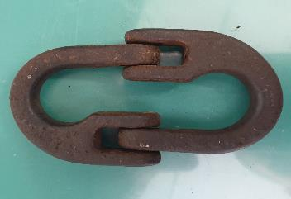
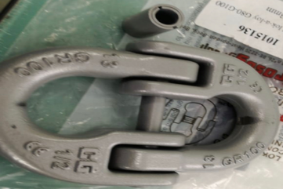
PDO Second Alert
Date: 28th October 2019 Incident: HiPo#66 DROPS
What happened?
While pulling out of hole drill string, the racking board winch chain with its attached hook (total weight 1.2kg) dropped down to the rig floor (height 17m).
Both halves of the Crosby chain connecting link “LoK A-Loy” were found, but connecting rod and the lock were not found. No body was in the Red Zone at that time.
Your learning from this incident..
Always ensure chain assembly on monkey board & all potential dropped objects are included in DROPs checklist
Always ensure racking board winch accessories are part of lifting gear checklist and inspected as per procedure
Always ensure to check and maintain equipment used above head height.
Always ensure to stay away from Red Zone area.
Always inspect and maintain the connecting links (LOK-A LOY) according to OEM.
Notes:
Ensure all dates and titles are input
A short description should be provided without mentioning names of contractors or individuals. You should include, what happened, to who (by job title) and what injuries this resulted in. Nothing more!
Four to five bullet points highlighting the main findings from the investigation. Remember the target audience is the front line staff so this should be written in simple terms in a way that everyone can understand.
The strap line should be the main point you want to get across
The images should be self explanatory, what went wrong (if you create a reconstruction please ensure you do not put people at risk) and below how it should be done.

Slide 2
Management self audit
Date: 28th October 2019 Incident: HiPo#66 DROPS
As a learning from this incident and ensure continual improvement all contract
managers must review their HSE HEMP against the questions asked below
Confirm the following:
Do you ensure, the derrick man is trained to look for possible drops objects?
Do you ensure, the drops inspection covers all parts and identifies the primary retentions and securing methods – including for any temporary replacements at height?
Do you ensure, the inspection program cover winch chains and other accessories.
* If the answer is NO to any of the above questions please ensure you take action to correct this finding.
Notes:
Ensure all dates and titles are input
Make a list of closed questions (only ‘yes’ or ‘no’ as an answer) to ask others if they have the same issues based on the management or HSE-MS failings or shortfalls identified in the investigation.
Imagine you have to audit other companies to see if they could have the same issues.
These questions should start with: Do you ensure…………………?

