Slide 1
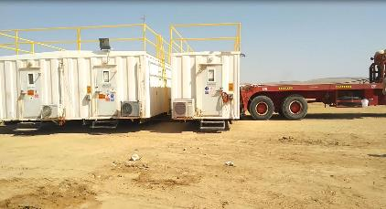
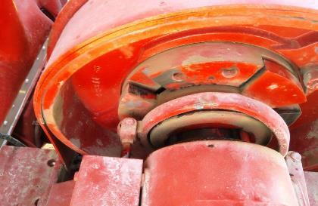
PDO Second Alert
Date: 25th October 2019 Incident Title: HiPo#68
What happened?
During the a camp move an oilfield truck was winching a 3 cabin skid, when the front of the skid was approximately 1m from the ground the winch has unspooled causing the skid to drop. The cabins suffered some structural and internal damages. There were no injuries.
Your learning from this incident.
Always check and confirm the winch clutch lock is properly engaged.
Make sure you check for hazards and people before you start winching.
Make sure that no one is in the line of fire when you are winching loads.
Always use your empowerment to stop if you feel that what you are doing is unsafe?
Report all defects to the workshop team?
Visually check the winch lock is in place before using the winch
Notes:
Ensure all dates and titles are input
A short description should be provided without mentioning names of contractors or individuals. You should include, what happened, to who (by job title) and what injuries this resulted in. Nothing more!
Four to five bullet points highlighting the main findings from the investigation. Remember the target audience is the front line staff so this should be written in simple terms in a way that everyone can understand.
The strap line should be the main point you want to get across
The images should be self explanatory, what went wrong (if you create a reconstruction please ensure you do not put people at risk) and below how it should be done.

Slide 2
Management self audit
Date: 25th October 2019 Incident Title: HiPo#68
As a learning from this incident and ensure continual improvement all contract
managers must review their HSE HEMP against the questions asked below
Confirm the following:
Do you ensure the relevant staff are aware of the correct procedure of checking the winch clutch lock before they carry out a winching operation?
Do you ensure that all your staff have been competency assessed and carry out their roles in accordance with agreed procedures?
Do you ensure that are reminded of these procedures during toolbox talks?
Do you ensure that winching operations are assured with audits and inspections?
Do you ensure that all equipment is serviced and maintained in accordance with the manufacturers requirements and that staff are competent to determine what is required?
* If the answer is NO to any of the above questions please ensure you take action to correct this finding.
Notes:
Ensure all dates and titles are input
Make a list of closed questions (only ‘yes’ or ‘no’ as an answer) to ask others if they have the same issues based on the management or HSE-MS failings or shortfalls identified in the investigation.
Imagine you have to audit other companies to see if they could have the same issues.
These questions should start with: Do you ensure…………………?

