Slide 1
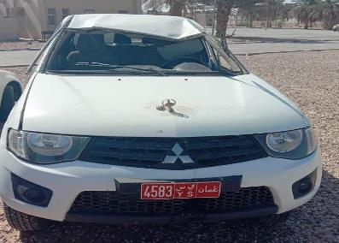
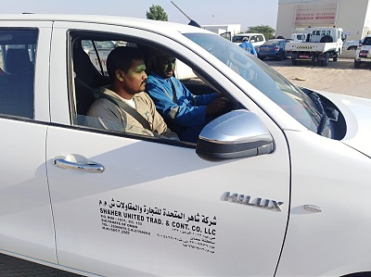
PDO FIRST ALERT
Date:12th November 2019 Incident title: MVI rollover
What happened?
The driver lost control of his vehicle whilst travelling near Yibal graded road, the vehicle moved to opposite track (Due to lack of attention) and in an attempt to revert it back to proper track it rolled over.
Your learning from this incident..
Always ensure that you take permission from Supervisor for any journey.
Always ensure you follow defensive driving techniques
Always ensure you use the Panic button in case of emergency when you are in accident.
Always ensure to pay attention on driving.
Always ensure to wear the seat belt
Follow and apply defensive driving techniques
Notes:
Ensure all dates and titles are input
A short description should be provided without mentioning names of contractors or individuals. You should include, what happened, to who (by job title) and what injuries this resulted in. Nothing more!
Four to five bullet points highlighting the main findings from the investigation. Remember the target audience is the front line staff so this should be written in simple terms in a way that everyone can understand.
The strap line should be the main point you want to get across
The images should be self explanatory, what went wrong (if you create a reconstruction please ensure you do not put people at risk) and below how it should be done.

Slide 2
Management self audit
Date:12th November 2019 Incident title: MVI rollover
As a Learning from this incident and ensure continual improvement all contract management must must review their HSE HEMP against the questions asked below
Confirm the following:
Do you ensure all vehicle movement are authorized
Do you ensure all drivers behaviors are monitored and analyzed
Do you ensure drivers incentives based on IVMS data analysis
Do you ensure all drivers attend drivers forum and encourage them to apply defensive driving techniques
Do you ensure emergency response procedure are being followed.
*If the answer is NO to any of the above questions please ensure you take action to correct this finding.
Notes:
Ensure all dates and titles are input
Make a list of closed questions (only ‘yes’ or ‘no’ as an answer) to ask others if they have the same issues based on the management or HSE-MS failings or shortfalls identified in the investigation.
Imagine you have to audit other companies to see if they could have the same issues.
These questions should start with: Do you ensure…………………?

