Slide 1
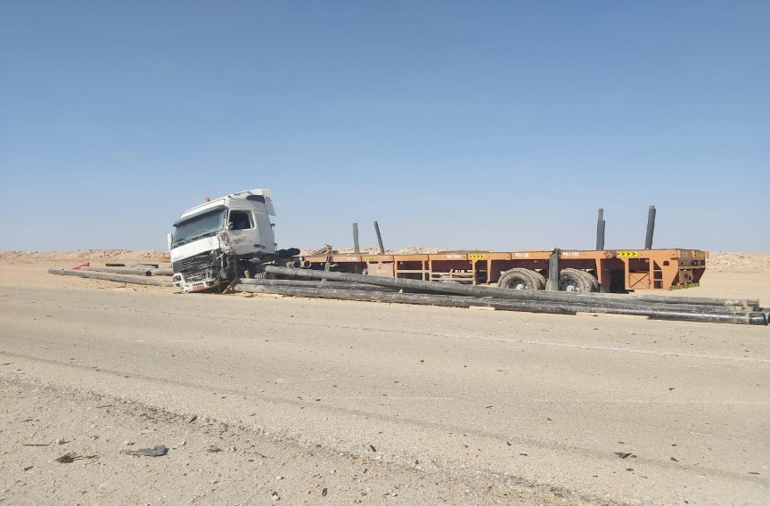
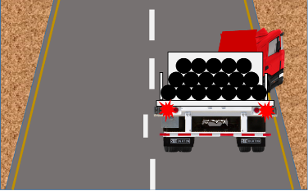
PDO Second Alert
Date: 3rd November 2019 Incident title: 3rd Party Fatality
What happened?
A Heavy Goods Vehicle (HGV) was involved in a Motor Vehicle Incident (MVI) with a 3rd party light vehicle. The HGV was travelling on a single carriageway road, when the 3rd party vehicle suddenly entered the path of the HGV. The HGV driver was unable to avoid the 3rd party vehicle resulting in both vehicles making contact on the driver side front quarters. The driver of the 3rd party vehicle was fatally injured as a result of the incident, the HGV driver received minor bruising to his leg and chest.
Your learning from this incident.
Always adjust your speed when faced with a hazard
Always adjust your road position when faced with a hazard
Always warn other drivers of hazards by using your horn
Always read the road ahead
Always apply defensive driving techniques
Always ensure vehicles are fit for use and ensure headboards meet required standards
Always ensure your load is adequately secure in accordance with SP2001
Look ahead and adjust your driving accordingly

Slide 2
Management self audit
Date: 3rd November 2019 Incident title: 3rd Party Fatality
As a learning from this incident and ensure continual improvement all contract
managers must review their HSE HEMP against the questions asked below
Confirm the following:
Do you ensure drivers know the risks of not wearing a seatbelt?
Do you ensure all operational sites are subject to relevant audits and inspections?
Do you ensure the quality of load security equipment?
Do you ensure the journey management procedure is follow correctly?
Do you ensure vehicles meet the required standards?
Do you ensure hazards presented by 3rd party vehicles are communicated to drivers?
Do you ensure compliance to SP2000 / SP2001?
* If the answer is NO to any of the above questions please ensure you take action to correct this finding.
Notes:
Ensure all dates and titles are input
Make a list of closed questions (only ‘yes’ or ‘no’ as an answer) to ask others if they have the same issues based on the management or HSE-MS failings or shortfalls identified in the investigation.
Imagine you have to audit other companies to see if they could have the same issues.
These questions should start with: Do you ensure…………………?

