Slide 1
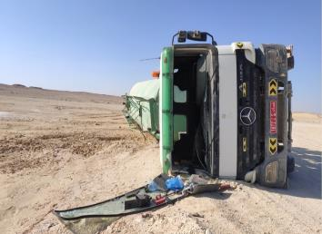
PDO Second Alert
Date: 23rd November 2019 Incident title: HiPo MVI rollover
What happened?
A fully loaded brackish water tanker was traveling from Alnoor water well towards Bodour on the graded road. At the T-Junction near Al Shomou, while taking left turn, the driver lost control & the vehicle tilted and fell on its right side.
Your learning from this incident..
Always follow defensive driving techniques.
Always follow both defensive driving techniques and speed requirements applicable to the road conditions.
Always drive to the road conditions.
Always slow down before approaching T junctions / turnings.
Make sure you are at the safe speed while taking a turn
Notes:
Ensure all dates and titles are input
A short description should be provided without mentioning names of contractors or individuals. You should include, what happened, to who (by job title) and what injuries this resulted in. Nothing more!
Four to five bullet points highlighting the main findings from the investigation. Remember the target audience is the front line staff so this should be written in simple terms in a way that everyone can understand.
The strap line should be the main point you want to get across
The images should be self explanatory, what went wrong (if you create a reconstruction please ensure you do not put people at risk) and below how it should be done.

Slide 2
Management self audit
Date: 23rd November 2019 Incident title: HiPo MVI rollover
As a learning from this incident and ensure continual improvement all contract
managers must review their HSE HEMP against the questions asked below
Confirm the following:
Do you ensure all drivers are competent, experienced and properly trained to drive on graded roads?
Do you ensure your HEMP cover driving in Interior locations?
Do you ensure your sub-contractors’ vehicles are RAS certified?
Do you cascade Incident learnings among your sub-contractors?
*If the answer is NO to any of the above questions please ensure you take action to correct this finding.
Notes:
Ensure all dates and titles are input
Make a list of closed questions (only ‘yes’ or ‘no’ as an answer) to ask others if they have the same issues based on the management or HSE-MS failings or shortfalls identified in the investigation.
Imagine you have to audit other companies to see if they could have the same issues.
These questions should start with: Do you ensure…………………?

