Slide 1
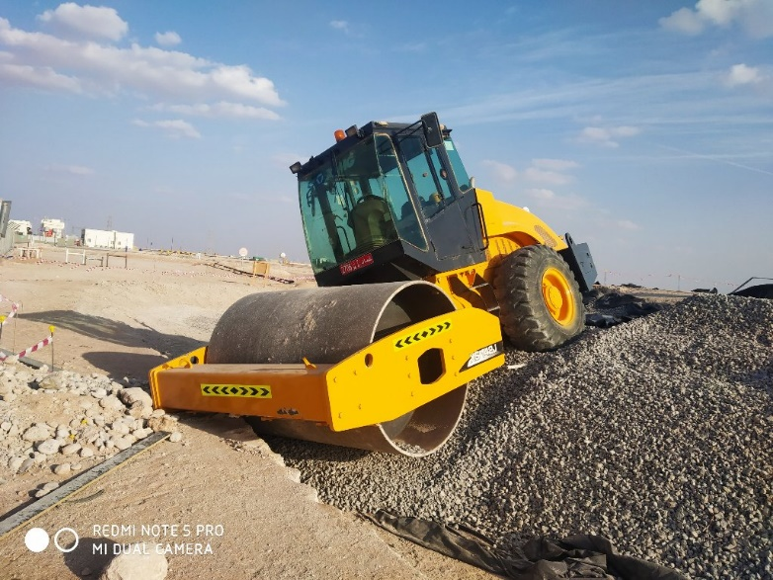
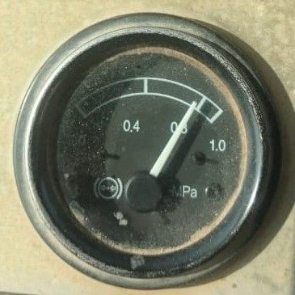
PDO Second Alert
Date:18th November 2019 Incident title: Worksite hazards
What happened?
A civil crew of three personnel (Permit holder, Roller Compactor operator and Banks man) were performing compaction of new tank foundation using a 10 ton Roller Compactor with air assisted hydraulic brake and clutch. The operator drove the Roller Compactor without ensuring sufficient air built up and lost control of the equipment due to ineffective brake and clutch. The operator jumped out of the equipment in panic before it ran out of the edge of the tank pad area and finally rested on the tank foundation base. There was no injury or asset damage in the incident.
Your learning from this incident..
Always follow Original Equipment Manufacturer (OEM) operating procedure/safety guidelines when driving /operating heavy equipment’s
Always ensure adequate air pressure in braking system
Discuss the hazards related to heavy equipment operation in Tool Box Talk
Always follow the OEM safe operating procedure
Notes:
Ensure all dates and titles are input
A short description should be provided without mentioning names of contractors or individuals. You should include, what happened, to who (by job title) and what injuries this resulted in. Nothing more!
Four to five bullet points highlighting the main findings from the investigation. Remember the target audience is the front line staff so this should be written in simple terms in a way that everyone can understand.
The strap line should be the main point you want to get across
The images should be self explanatory, what went wrong (if you create a reconstruction please ensure you do not put people at risk) and below how it should be done.

Slide 2
Management self audit
Date:18th November 2019 Incident title: Worksite hazards
As a learning from this incident and ensure continual improvement all contract
managers must review their HSE HEMP against the questions asked below
Confirm the following:
Do you ensure that heavy equipment’s have a copy of OEM safe operating manual available with the equipment/operator?
Do you confirm that the heavy equipment operators are competent and aware of OEM guidelines and safety functions of the equipment?
Do you ensure your operators are aware of the operational limits and do’s & don’ts while operating their equipment?
Do you ensure that the employees involved in heavy equipment operation are aware of the operational limits of the equipment?
* If the answer is NO to any of the above questions please ensure you take action to correct this finding.
Notes:
Ensure all dates and titles are input
Make a list of closed questions (only ‘yes’ or ‘no’ as an answer) to ask others if they have the same issues based on the management or HSE-MS failings or shortfalls identified in the investigation.
Imagine you have to audit other companies to see if they could have the same issues.
These questions should start with: Do you ensure…………………?

