Slide 1
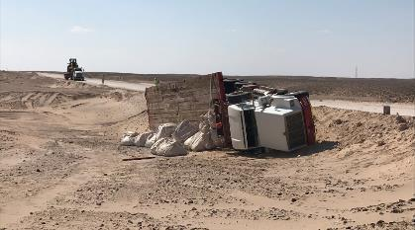
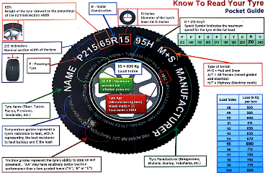
PDO Second Alert
Date: 26th November 2019 Incident Title: HiPo#76
What happened?
A truck was travelling on a graded, when it suffered a puncture to the front right tyre (passenger side). The deflation caused the vehicle to pull to the right and subsequently off the road and down an embankment, resulting in the vehicle tipping onto it’s passenger side. The driver was unhurt in the incident.
Your learning from this incident.
Always check your tyre conditions prior to departure on any journey.
Always check your tyres during rest stops and regularly throughout your journey.
Always ensure your vehicle has the correct tyre pressure prior to departure on any journey.
Ensure you follow defensive driver training methods
Conduct regular tyre checks during a journey, especially on graded roads
Notes:
Ensure all dates and titles are input
A short description should be provided without mentioning names of contractors or individuals. You should include, what happened, to who (by job title) and what injuries this resulted in. Nothing more!
Four to five bullet points highlighting the main findings from the investigation. Remember the target audience is the front line staff so this should be written in simple terms in a way that everyone can understand.
The strap line should be the main point you want to get across
The images should be self explanatory, what went wrong (if you create a reconstruction please ensure you do not put people at risk) and below how it should be done.

Slide 2
Management self audit
Date: 26th November 2019 Incident Title: HiPo#76
As a learning from this incident and ensure continual improvement all contract
managers must review their HSE HEMP against the questions asked below
Confirm the following:
Do you ensure your staff are aware of the correct procedure of inspecting tyres before they start on their journey?
Do you ensure drivers are reminded of these vehicle / tyre checking procedures during toolbox talks and safety briefings?
Do you ensure quality checks are carried out on tyres on receipt from suppliers and prior to fitting on vehicles?
Do you ensure tyres are stored in accordance with SP2000?
* If the answer is NO to any of the above questions please ensure you take action to correct this finding.
Notes:
Ensure all dates and titles are input
Make a list of closed questions (only ‘yes’ or ‘no’ as an answer) to ask others if they have the same issues based on the management or HSE-MS failings or shortfalls identified in the investigation.
Imagine you have to audit other companies to see if they could have the same issues.
These questions should start with: Do you ensure…………………?

