Slide 1
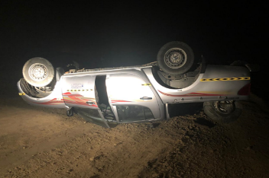
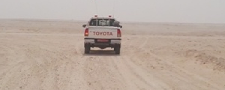
PDO Second Alert
Date: 27th November 2019 Incident HiPo MVI
What happened?
While leaving the site access road and joining to the main graded road, the back passenger requested the front passenger the auxiliary cable. The driver turned around and gave the cable to the rear passenger, at the same time, back passenger reported seeing dogs ahead. The driver/operator turn back to the front, saw the dogs and initially tried to manoeuvre to avoid hitting them (3 or 4 dogs), and took a sharp turn which led him to lose control of the vehicle and the vehicle rolled over.
Your learning from this incident..
Always ensure you drive at a speed limit according to the road & environmental conditions
Always obey the speed limit at night
Always ensure you slow down before approaching junctions, roundabouts, sharp bends & corners
Always pay extra attention to survey the road from any upcoming hazards
Always ensure you follow your defensive driver training (focus on the road)
Always ensure new drivers are on-boarded correctly and driver habits are assessed
Always ensure you intervene and don’t rush to get the job done
Slow Down when approaching junctions & apply defensive driving techniques
Notes:
Ensure all dates and titles are input
A short description should be provided without mentioning names of contractors or individuals. You should include, what happened, to who (by job title) and what injuries this resulted in. Nothing more!
Four to five bullet points highlighting the main findings from the investigation. Remember the target audience is the front line staff so this should be written in simple terms in a way that everyone can understand.
The strap line should be the main point you want to get across
The images should be self explanatory, what went wrong (if you create a reconstruction please ensure you do not put people at risk) and below how it should be done.

Slide 2
Management self audit
Date: 27th November 2019 Incident HiPo MVI
As a learning from this incident and ensure continual improvement all contract
managers must review their HSE HEMP against the questions asked below
Confirm the following:
Do you ensure drivers follow speed limit as per the road & environment condition?
Do you ensure new drivers are coached, supervised and competency assessed?
Do you ensure drivers always follow defensive driving techniques including dynamic risk assessment?
Do you ensure passenger(s) intervene to any unsafe behavior & never distract driver?
Do you ensure poor road conditions are reported?
* If the answer is NO to any of the above questions please ensure you take action to correct this finding.
Notes:
Ensure all dates and titles are input
Make a list of closed questions (only ‘yes’ or ‘no’ as an answer) to ask others if they have the same issues based on the management or HSE-MS failings or shortfalls identified in the investigation.
Imagine you have to audit other companies to see if they could have the same issues.
These questions should start with: Do you ensure…………………?

