Slide 1
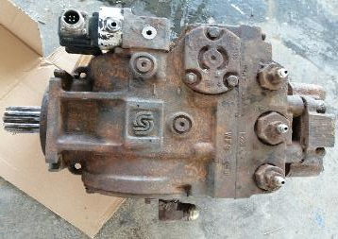
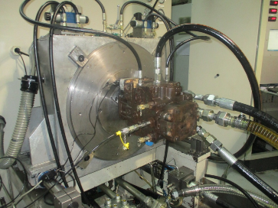
PDO Second Alert
Date: 23rd November 2019 Incident title: HiPo DROPS #79
What happened?
@ 8 :51 am, the Slickline Crew were rigging up to close and open the side slide door (SSD), in order to set and retrieve a plug and prong. The Slickline Operator lifted the 24’ lubricator and the tool string approximately one (1) meter from the ground while using the unit mounted-crane. Suddenly the wire drum started to pool in by itself. Causing the lubricator to be pull back towards the unit, which resulted in the slickline wire to part; causing the lubricator to swing and struck the rig floor. Consequently, there was no injuries and the mechanical jar was damaged.
Your learning from this incident..
Ensure that the Wire drum hydraulic motor is part of the company maintenance system.
Ensure that the emergency shutdown button is periodically tested.
Always follow OEM recommendations when maintaining equipment.
Only competent personnel undertake troubleshooting tasks.
Always check equipment for wear and tear.
Ensure that equipment third party inspection is carried out on regular basis.
Hydraulic Motor not maintained
Ensure your equipment is well maintained before you start work
Maintained Hydraulic Motor

Slide 2
Management self audit
Date: 23rd November 2019 Incident title: HiPo DROPS #79
As a learning from this incident and ensure continual improvement all contract
managers must review their HSE HEMP against the questions asked below
Confirm the following:
Do you ensure that all equipment are part of the preventive maintenance system?
Do you ensure that staff are competent for the job?
Do you ensure that emergency equipment are periodically tested ?
Do you ensure that your HEMP is regularly reviewed?
* If the answer is NO to any of the above questions please ensure you take action to correct this finding.

