Slide 1
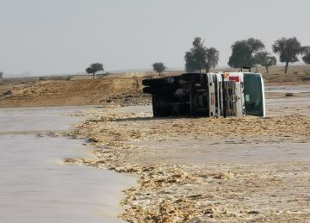
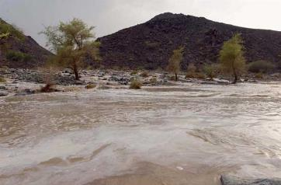
PDO Second Alert
Date:9th December 2019 Incident title HiPO #80
What happened?
A Tipper Truck was attempting to cross Wadi Almery which was flowing with water after heavy rain. Approximately half way through the Wadi the vehicle became over powered by the flow of the water and tipped on to its driver side. The driver escaped through the passenger door window and climbed on to the side of the tipper truck where he attempted to call 5555 but did not use the prefix of 2438.
Your learning from this incident.
Always follow ROP instruction on crossing wadis
Ensure you follow the Journey Manager instructions
Ensure you use the correct number to contact PDO emergency services, 5555 or 24675555 / 24385555
Ensure you do not succumb to peer pressure
Do not cross a flowing Wadi
Notes:
Ensure all dates and titles are input
A short description should be provided without mentioning names of contractors or individuals. You should include, what happened, to who (by job title) and what injuries this resulted in. Nothing more!
Four to five bullet points highlighting the main findings from the investigation. Remember the target audience is the front line staff so this should be written in simple terms in a way that everyone can understand.
The strap line should be the main point you want to get across
The images should be self explanatory, what went wrong (if you create a reconstruction please ensure you do not put people at risk) and below how it should be done.

Slide 2
Management self audit
Date:9th December 2019 Incident title HiPO #80
As a learning from this incident and ensure continual improvement all contract managers must review their HSE HEMP against the questions asked below:
Confirm the following:
Do you ensure your drivers know the dangers of crossing a flowing wadi?
Do you ensure all staff are aware of the correct emergency numbers and the requirement to call them?
Do you ensures that your drivers know their empowerment to STOP?
Do you ensure your Journey Managers understand the ongoing daily risks that the drivers will face?
Do you ensure you have adequate procedures for Emergency planning in all required situations?
Do your emergency drills cover effects from adverse weather?
* If the answer is NO to any of the above questions please ensure you take action to correct this finding.
Notes:
Ensure all dates and titles are input
Make a list of closed questions (only ‘yes’ or ‘no’ as an answer) to ask others if they have the same issues based on the management or HSE-MS failings or shortfalls identified in the investigation.
Imagine you have to audit other companies to see if they could have the same issues.
These questions should start with: Do you ensure…………………?

