Slide 1
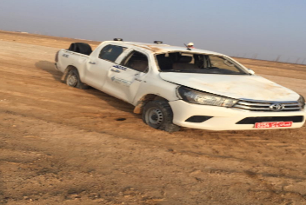

PDO Second Alert
Date: 6th December 2019 Incident title MVI RO HiPo#81
What happened?
At 0600 hrs, driver started a journey with a passenger from Wadi Musalam Well Test Site to Rig Camp (distance 5kms). After driving 3 km the driver lost control of the vehicle and the vehicle rolled over. Driver and passenger were not injured
Your learning from this incident..
Always ensure to drive as per the road condition
Always ensure to concentrate on the road while driving
Always ensure to apply defensive driving techniques
Always ensure to consider the sunrise and sunset when planning a journey
Always Comply with speed limits on graded roads
Notes:
Ensure all dates and titles are input
A short description should be provided without mentioning names of contractors or individuals. You should include, what happened, to who (by job title) and what injuries this resulted in. Nothing more!
Four to five bullet points highlighting the main findings from the investigation. Remember the target audience is the front line staff so this should be written in simple terms in a way that everyone can understand.
The strap line should be the main point you want to get across
The images should be self explanatory, what went wrong (if you create a reconstruction please ensure you do not put people at risk) and below how it should be done.

Slide 2
Management self audit
Date: 6th December 2019 Incident title MVI RO HiPo#81
As a learning from this incident and ensure continual improvement all contract
managers must review their HSE HEMP against the questions asked below
Confirm the following:
Do you ensure the driver familiar with the route
Do you ensure the drivers attended the road safety awareness sessions
Do you ensure drivers apply defensive driving techniques
Do you ensure drivers behavior is analyses using IVMS tools
Notes:
Ensure all dates and titles are input
Make a list of closed questions (only ‘yes’ or ‘no’ as an answer) to ask others if they have the same issues based on the management or HSE-MS failings or shortfalls identified in the investigation.
Imagine you have to audit other companies to see if they could have the same issues.
These questions should start with: Do you ensure…………………?

