Slide 1
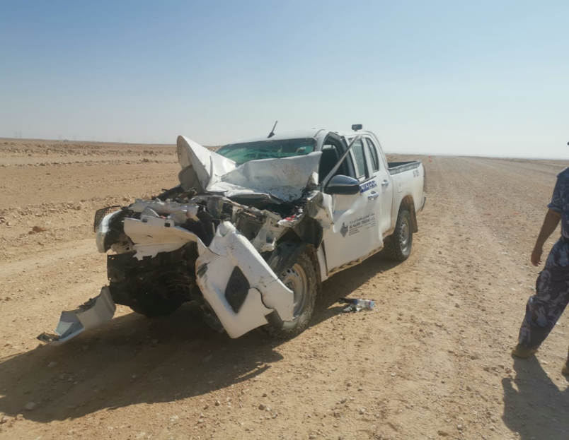
PDO Second Alert
Date:11th December 2019 Incident title : MVI HiPo#82
What happened?
An operator left the site to make a phone call, on his way back to site at @10:00 hrs , while driving, on a graded road, behind a water tanker, he tried to over take. when another car was coming from the opposite direction so upon returning to his lane at a high speed he hit the rear of the water tanker.
Your learning from this incident..
Always ensure that your car key and IVMS tag are secured and no one have access to it.
Always ensure to comply with speed limits
Always ensure to overtake when its clear and safe
Always ensure to keep safe distance behind front vehicle
Only drive when you are trained and authorized
Notes:
Ensure all dates and titles are input
A short description should be provided without mentioning names of contractors or individuals. You should include, what happened, to who (by job title) and what injuries this resulted in. Nothing more!
Four to five bullet points highlighting the main findings from the investigation. Remember the target audience is the front line staff so this should be written in simple terms in a way that everyone can understand.
The strap line should be the main point you want to get across
The images should be self explanatory, what went wrong (if you create a reconstruction please ensure you do not put people at risk) and below how it should be done.

Slide 2
Management self audit
Date:11th December 2019 Incident title :HiPo#82
As a learning from this incident and ensure continual improvement all contract
managers must review their HSE HEMP against the questions asked below
Confirm the following:
Do you ensure that only authorized and trained drivers are driving company vehicles?
Do you ensure that your remote locations are properly managed and supervised?
Do you ensure your crew are having communication methods in remote areas?
Do you ensure person in charge doesn’t leave the site?
If the answer is NO to any of the above questions please ensure you take action to correct this finding.
Notes:
Ensure all dates and titles are input
Make a list of closed questions (only ‘yes’ or ‘no’ as an answer) to ask others if they have the same issues based on the management or HSE-MS failings or shortfalls identified in the investigation.
Imagine you have to audit other companies to see if they could have the same issues.
These questions should start with: Do you ensure…………………?

