Slide 1
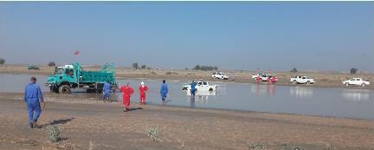
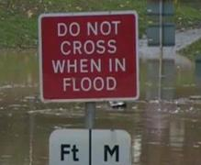
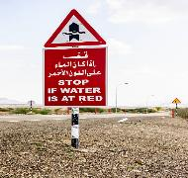
PDO Second Alert
Date: 10th December 2019 Incident title:HiPo#83
What happened?
A Hilux vehicle got stuck in the shallow water. A unimog truck was use to recovering the Hilux vehicle. Two Webbing slings were attached with D shackles, while recovering the Hilux vehicle webbing sling was released from unimog towing hook due to sudden tension released and joined D shackle hit the Hilux wind screen. No injury was sustained by the driver.
Your learning from this incident..
Always Ensure that towing procedure is followed
Always ask Authorized and experienced personnel to perform the specific task
Always Ensure that you are away from standing & flowing water
Always select a safe route
Always Follow the proper procedure , don’t use shortcuts
Notes:
Ensure all dates and titles are input
A short description should be provided without mentioning names of contractors or individuals. You should include, what happened, to who (by job title) and what injuries this resulted in. Nothing more!
Four to five bullet points highlighting the main findings from the investigation. Remember the target audience is the front line staff so this should be written in simple terms in a way that everyone can understand.
The webbing slings line should be the main point you want to get across
The images should be self explanatory, what went wrong (if you create a reconstruction please ensure you do not put people at risk) and below how it should be done.

Slide 2
Management self audit
Date: 10th December 2019 Incident title: HiPo Asset Damage
As a learning from this incident and ensure continual improvement all contract
managers must review their HSE RAR against the questions asked below
Confirm the following:
Do you ensure all towing operation team members are trained and authorized to perform work?
Do you ensure all towing equipments in controlled system?
Do you ensure all towing equipments are certified?
Do you ensure that all the HSE procedures are discussed & communicated in detail?
Do you ensure that all field activities mitigated during/after natural setback?
Do you ensure that HEMP (RAR, Risk Assessment Register) is updated about water crossing?
Do You ensure that MOPO is applicable after flood in project area?
* If the answer is NO to any of the above questions please ensure you take action to correct this finding.
Notes:
Ensure all dates and titles are input
Make a list of closed questions (only ‘yes’ or ‘no’ as an answer) to ask others if they have the same issues based on the management or HSE-MS failings or shortfalls identified in the investigation.
Imagine you have to audit other companies to see if they could have the same issues.
These questions should start with: Do you ensure…………………?

