Slide 1
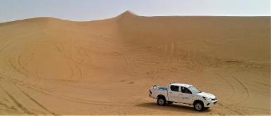
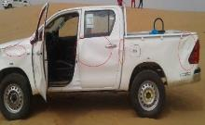
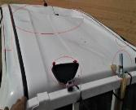
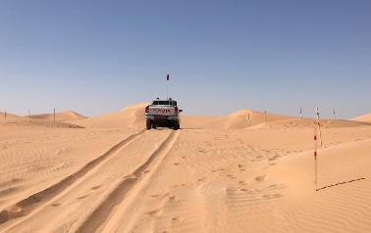
PDO Second Alert
Date: 19th December 2019 Incident title: HiPo#83a MVI
What happened?
After a driver dropped his survey team at work location in field , and he chose to the drive toward sand dune and left the dozer track. He made several attempts at circular driving slip face of sand dune, and suddenly, he lost control and vehicle rolled over once on 360° and landed on his wheels. Fortunately driver escaped from vehicle and no injury was sustained.
Your learning from this incident..
Always ensure that you are driving on the dozer access tracks & safe route.
Always avoid the reckless behavior at work place.
Do not drive steep gradient (slip face) of sand dune, be aware it can harm you.
Always ensure that active VTS (Vehicle tracking system) monitoring is in placed
Always pay attention on your working surroundings and utilize defensive driving techniques while driving.
Don’t chose an unauthorized route to drive
Notes:
Ensure all dates and titles are input
A short description should be provided without mentioning names of contractors or individuals. You should include, what happened, to who (by job title) and what injuries this resulted in. Nothing more!
Four to five bullet points highlighting the main findings from the investigation. Remember the target audience is the front line staff so this should be written in simple terms in a way that everyone can understand.
The strap line should be the main point you want to get across
The images should be self explanatory, what went wrong (if you create a reconstruction please ensure you do not put people at risk) and below how it should be done.

Slide 2
Management self audit
Date: 19th December 2019 Incident title: HiPo#83a MVI
As a learning from this incident and ensure continual improvement all contract
managers must review their HSE HEMP against the questions asked below
Confirm the following:
Do you ensure well developed sand dune driving procedure are implemented?
Do you ensure the competency of the driver is assess at crew level?
Do you ensure crew vehicle are actively monitored through VTS (Vehicle Tracking System)?
Do you ensure that all new drivers are effectively supervised all the time.?
Do you ensure that new drivers are managed properly and according to work risk level?
* If the answer is NO to any of the above questions please ensure you take action to correct this finding.
Notes:
Ensure all dates and titles are input
Make a list of closed questions (only ‘yes’ or ‘no’ as an answer) to ask others if they have the same issues based on the management or HSE-MS failings or shortfalls identified in the investigation.
Imagine you have to audit other companies to see if they could have the same issues.
These questions should start with: Do you ensure…………………?

