Slide 1
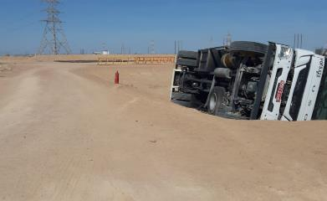
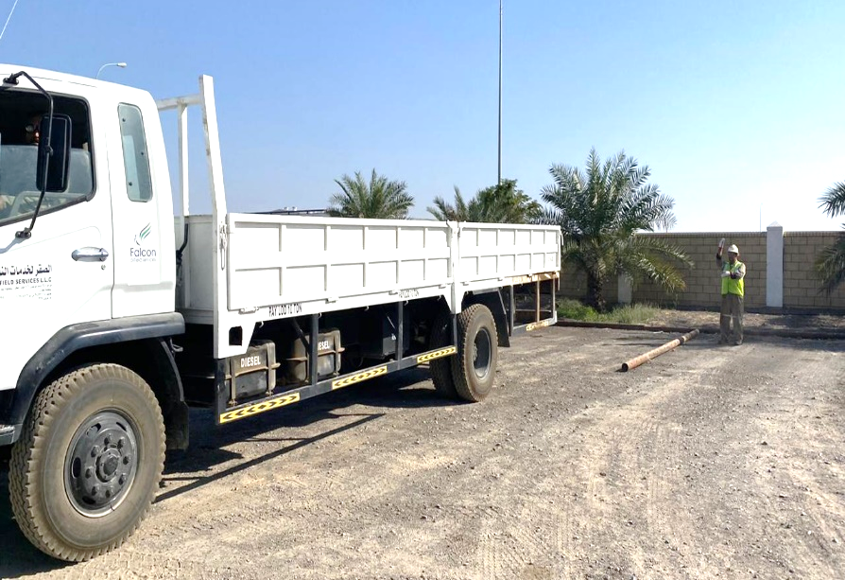
PDO Second Alert
Date: 27th December 2019 Incident title: HiPo#87 MVI
What happened?
While reversing to park the vehicle properly, the Driver (Operator) reversed off onto a lower elevation which slopes down to a small ditch. The sudden drop in the road level in addition to the load being carried made the vehicle become unbalanced causing the Driver to lose control of the vehicle and resulted in the truck falling on its side (Driver’s side).
Your learning from this incident..
Always ensure you check your surrounding for hazards in unfamiliar areas before moving your vehicle.
Always ensure new employees on the job are monitored and supervised.
Always ensure you ASK for help, if you cannot see clearly behind you when reversing.
Always ensure that a safety briefing is conducted prior to performing tasks.
Always Stop and check around the vehicle before reversing in an unknown area.
Notes:
Ensure all dates and titles are input
A short description should be provided without mentioning names of contractors or individuals. You should include, what happened, to who (by job title) and what injuries this resulted in. Nothing more!
Four to five bullet points highlighting the main findings from the investigation. Remember the target audience is the front line staff so this should be written in simple terms in a way that everyone can understand.
The strap line should be the main point you want to get across
The images should be self explanatory, what went wrong (if you create a reconstruction please ensure you do not put people at risk) and below how it should be done.

Slide 2
Management Self Audit
Date: 27th December 2019 Incident title: HiPo#87 MVI
As a learning from this incident and ensure continual improvement all contract
managers must review their HSE HEMP against the questions asked below
Confirm the following:
Do you ensure that your employees are competent in hazard identification?
Do you ensure that your Short Service Employees management system is effective?
Do you ensure that your procedures are frequently reviewed for continued relevance and adequacy?
Do you ensure your risk management tools identify and cover all the risks involved in the tasks?
Do you ensure compliance to your risk management tools is monitored?
* If the answer is NO to any of the above questions please ensure you take action to correct this finding.
Notes:
Ensure all dates and titles are input
Make a list of closed questions (only ‘yes’ or ‘no’ as an answer) to ask others if they have the same issues based on the management or HSE-MS failings or shortfalls identified in the investigation.
Imagine you have to audit other companies to see if they could have the same issues.
These questions should start with: Do you ensure…………………?

