Slide 1
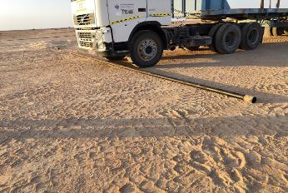
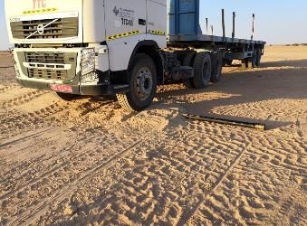
PDO Second Alert
Date: 03.11.2019 Incident title: LTI (Fracture Fibula – RT Ankle)
What happened?
On 03.11.2019 @ 09:49, The trailer loaded with 3 1/2 tubing material was directed to pass over the metal extension sewage line behind hoist offices. Forklift Operator was engaged to signal the trailer driver, the Crane Operator (CO- Person Injured) who was observing the crossing, decided to stable the metal sewage line extension using stone, after placing while backing off the pipe spun up and hit the CO in the right ankle causing fracture in fibula bone near ankle
Your learning from this incident..
Always check your position for doing the Job safely
Always coordinate with the crew to provide any support if required
Ensure correct access/ protection when crossing over pipes & Cables
Always discuss non-routine tasks and associated hazards with crew before start
Check & Stay away from Line of Fire
Notes:
Ensure all dates and titles are input
A short description should be provided without mentioning names of contractors or individuals. You should include, what happened, to who (by job title) and what injuries this resulted in. Nothing more!
Four to five bullet points highlighting the main findings from the investigation. Remember the target audience is the front line staff so this should be written in simple terms in a way that everyone can understand.
The strap line should be the main point you want to get across
The images should be self explanatory, what went wrong (if you create a reconstruction please ensure you do not put people at risk) and below how it should be done.

Slide 2
Management self audit
3rd Nov 2019: Medco LTI
As a learning from this incident and ensure continual improvement all contract
managers must review their HSE HEMP against the questions asked below
Confirm the following:
Do you ensure that your employees know the hazard prior to task is being carried out?
Do you ensure that all task hazard is addressed in HEMP and control measures are known?
Do ensure that critical / Non Routine tasks are to be adequately supervised?
Do you have and implement MOC in you activity.
* If the answer is NO to any of the above questions please ensure you take action to correct this finding.
Notes:
Ensure all dates and titles are input
Make a list of closed questions (only ‘yes’ or ‘no’ as an answer) to ask others if they have the same issues based on the management or HSE-MS failings or shortfalls identified in the investigation.
Imagine you have to audit other companies to see if they could have the same issues.
These questions should start with: Do you ensure…………………?

