Slide 1
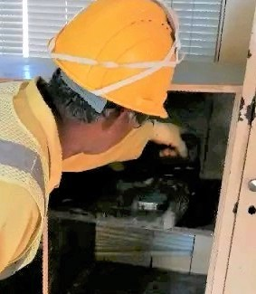
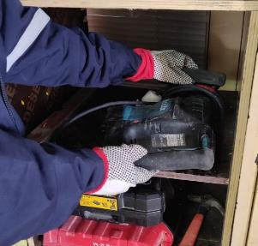
PDO Second Alert
Date: 25th Dec 2019 Incident: LTI#21
What happened?
Operative removed Makita Demolition hammer, weighing approximately 7kg from enclosed shelf with one hand, he lost control of the hammer drill that fell to the floor. He tried to catch the hammer drill before it hit the floor, on doing he trapped his hand between the hammer drill and the floor causing a mild fracture to his small finger on his right hand
Your learning from this incident..
Always ensure that you check all loads before lifting
Always ensure that you have control of the object before you lift
Always ask for assistance if objects are heavy or awkward to lift
Always check for hazards in the area before undertaking any manual handling of heavy loads
Always ensure that store heavy objects are in an easy to reach location
Lift Smart, Look, Think, Then Start!
Notes:
Ensure all dates and titles are input
A short description should be provided without mentioning names of contractors or individuals. You should include, what happened, to who (by job title) and what injuries this resulted in. Nothing more!
Four to five bullet points highlighting the main findings from the investigation. Remember the target audience is the front line staff so this should be written in simple terms in a way that everyone can understand.
The strap line should be the main point you want to get across
The images should be self explanatory, what went wrong (if you create a reconstruction please ensure you do not put people at risk) and below how it should be done.

Slide 2
Management self audit
Date: 25th Dec 2019 Incident: LTI#21
As a learning from this incident and ensure continual improvement all contract
managers must review their HSE HEMP against the questions asked below
Confirm the following:
Do you ensure that all staff are aware of all risks associated with their activities
Do you ensure that all staff are adequately trained in safe lifting and that the knowledge of training has been transferred to your staff
Do you ensure that frequent updates of training are applied
Do you ensure that Hazard hunts are carried out on a regular basis, the HEMP is revised accordingly and communicated through reflective learning
Do you ensure that frequent inspections of the workplace are undertaken
Do you ensure that you identify any ergonomic risk with storage of equipment.
* If the answer is NO to any of the above questions please ensure you take action to correct this finding.
Notes:
Ensure all dates and titles are input
Make a list of closed questions (only ‘yes’ or ‘no’ as an answer) to ask others if they have the same issues based on the management or HSE-MS failings or shortfalls identified in the investigation.
Imagine you have to audit other companies to see if they could have the same issues.
These questions should start with: Do you ensure…………………?

