Slide 1
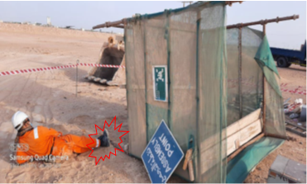
PDO Incident First Alert
Incident Type | LTI#11 | Pattern | Struck by
Date / Time | 13.6.2020@16:40hrs | Directorate
Location | Qarn Alam | Dept
Target Audience
Construction, Operations, Logistics, Engineering , Exploration & Drilling
What happened
A civil crew were about to leave site, the scaffold rest shelter toppled over striking the Civil Technician’s on his right leg.
Mr. Musleh asks the questions of can it happen to you?
How do you ensure you identify all hazards before starting a task?
Do you consider “what could go wrong?”
Do you consider if you are away from ‘line of fire’ released energy?
Please disseminate this LTI notification to your teams and use it in your tool box talks and HSE meetings and notice boards.

