Slide 1
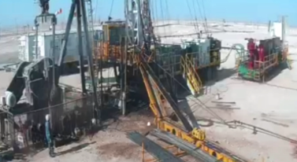
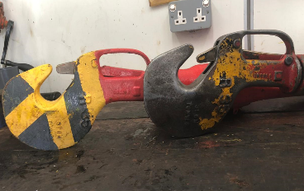
PDO Second Alert
Date: 15th December 2019 Incident title: HiPo#84 Drops
What happened?
While RIH Sucker rod completion, the 6th Sinker bar was picked up using sucker rod elevator from power catwalk, Assistant Driller (AD) realized the block was near racking board and applied sudden brake (jerk). As a result, the elevator came off the SR hook causing the sinker bar and the elevator (100Kg) to drop (13m) to ground. No injuries. No damages to equipment.
Your learning from this incident..
Always ensure to maintain a safe working speed and assess all the dynamic risks associated with external factors (wind speed, visibility….etc.).
Always ensure tubular handling equipment are checked before use.
Always follow the proper inspection procedures for handling equipment.
Always ensure all defected equipment are repaired/changed immediately.
Don’t Rush: Speed Kills
Inspect Handling Equipment / Tools Before Use
Notes:
Ensure all dates and titles are input
A short description should be provided without mentioning names of contractors or individuals. You should include, what happened, to who (by job title) and what injuries this resulted in. Nothing more!
Four to five bullet points highlighting the main findings from the investigation. Remember the target audience is the front line staff so this should be written in simple terms in a way that everyone can understand.
The strap line should be the main point you want to get across
The images should be self explanatory, what went wrong (if you create a reconstruction please ensure you do not put people at risk) and below how it should be done.

Slide 2
Management self audit
Date: 15th December 2019 Incident title: HiPo#84 Drops
As a learning from this incident and ensure continual improvement all contract
managers must review their HSE HEMP against the questions asked below
Confirm the following:
Do you ensure, the crew know the risk of over speeding and rushing?
Do you ensure, the crew knows their responsibilities to inspect handling tools before usage?
Do you ensure, the repair jobs are conducted using the correct spare parts?
Do you ensure, the crew are carrying out daily checklists correctly?
Do you ensure, the crew are conducting maintenance as per the maintenance program?
* If the answer is NO to any of the above questions please ensure you take action to correct this finding.
Notes:
Ensure all dates and titles are input
Make a list of closed questions (only ‘yes’ or ‘no’ as an answer) to ask others if they have the same issues based on the management or HSE-MS failings or shortfalls identified in the investigation.
Imagine you have to audit other companies to see if they could have the same issues.
These questions should start with: Do you ensure…………………?

