Slide 1
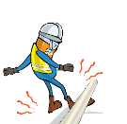
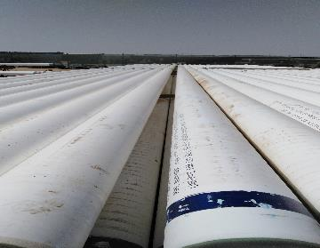
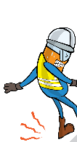
PDO Incident First Alert
Incident Type | LTI#12 | Pattern | Slip, trip & fall
Date / Time | 30.06.2020@06:30hrs | Directorate
Location | Qarn Alam | Dept
Target Audience
Construction, Operations, Logistics, Engineering , Exploration & Drilling
What happened
A Technician was aligning pipes in the yard when a pipe slid, trapping his leg resulted in a fracture to his right ankle.
Mr. Musleh asks the questions of can it happen to you?
How do you ensure you identify all hazards before starting a task?
Do you consider “what could go wrong?”
Do you ensure you follow the correct method to perform the job?
Please disseminate this LTI notification to your teams and use it in your tool box talks and HSE meetings and notice boards.

