Slide 1
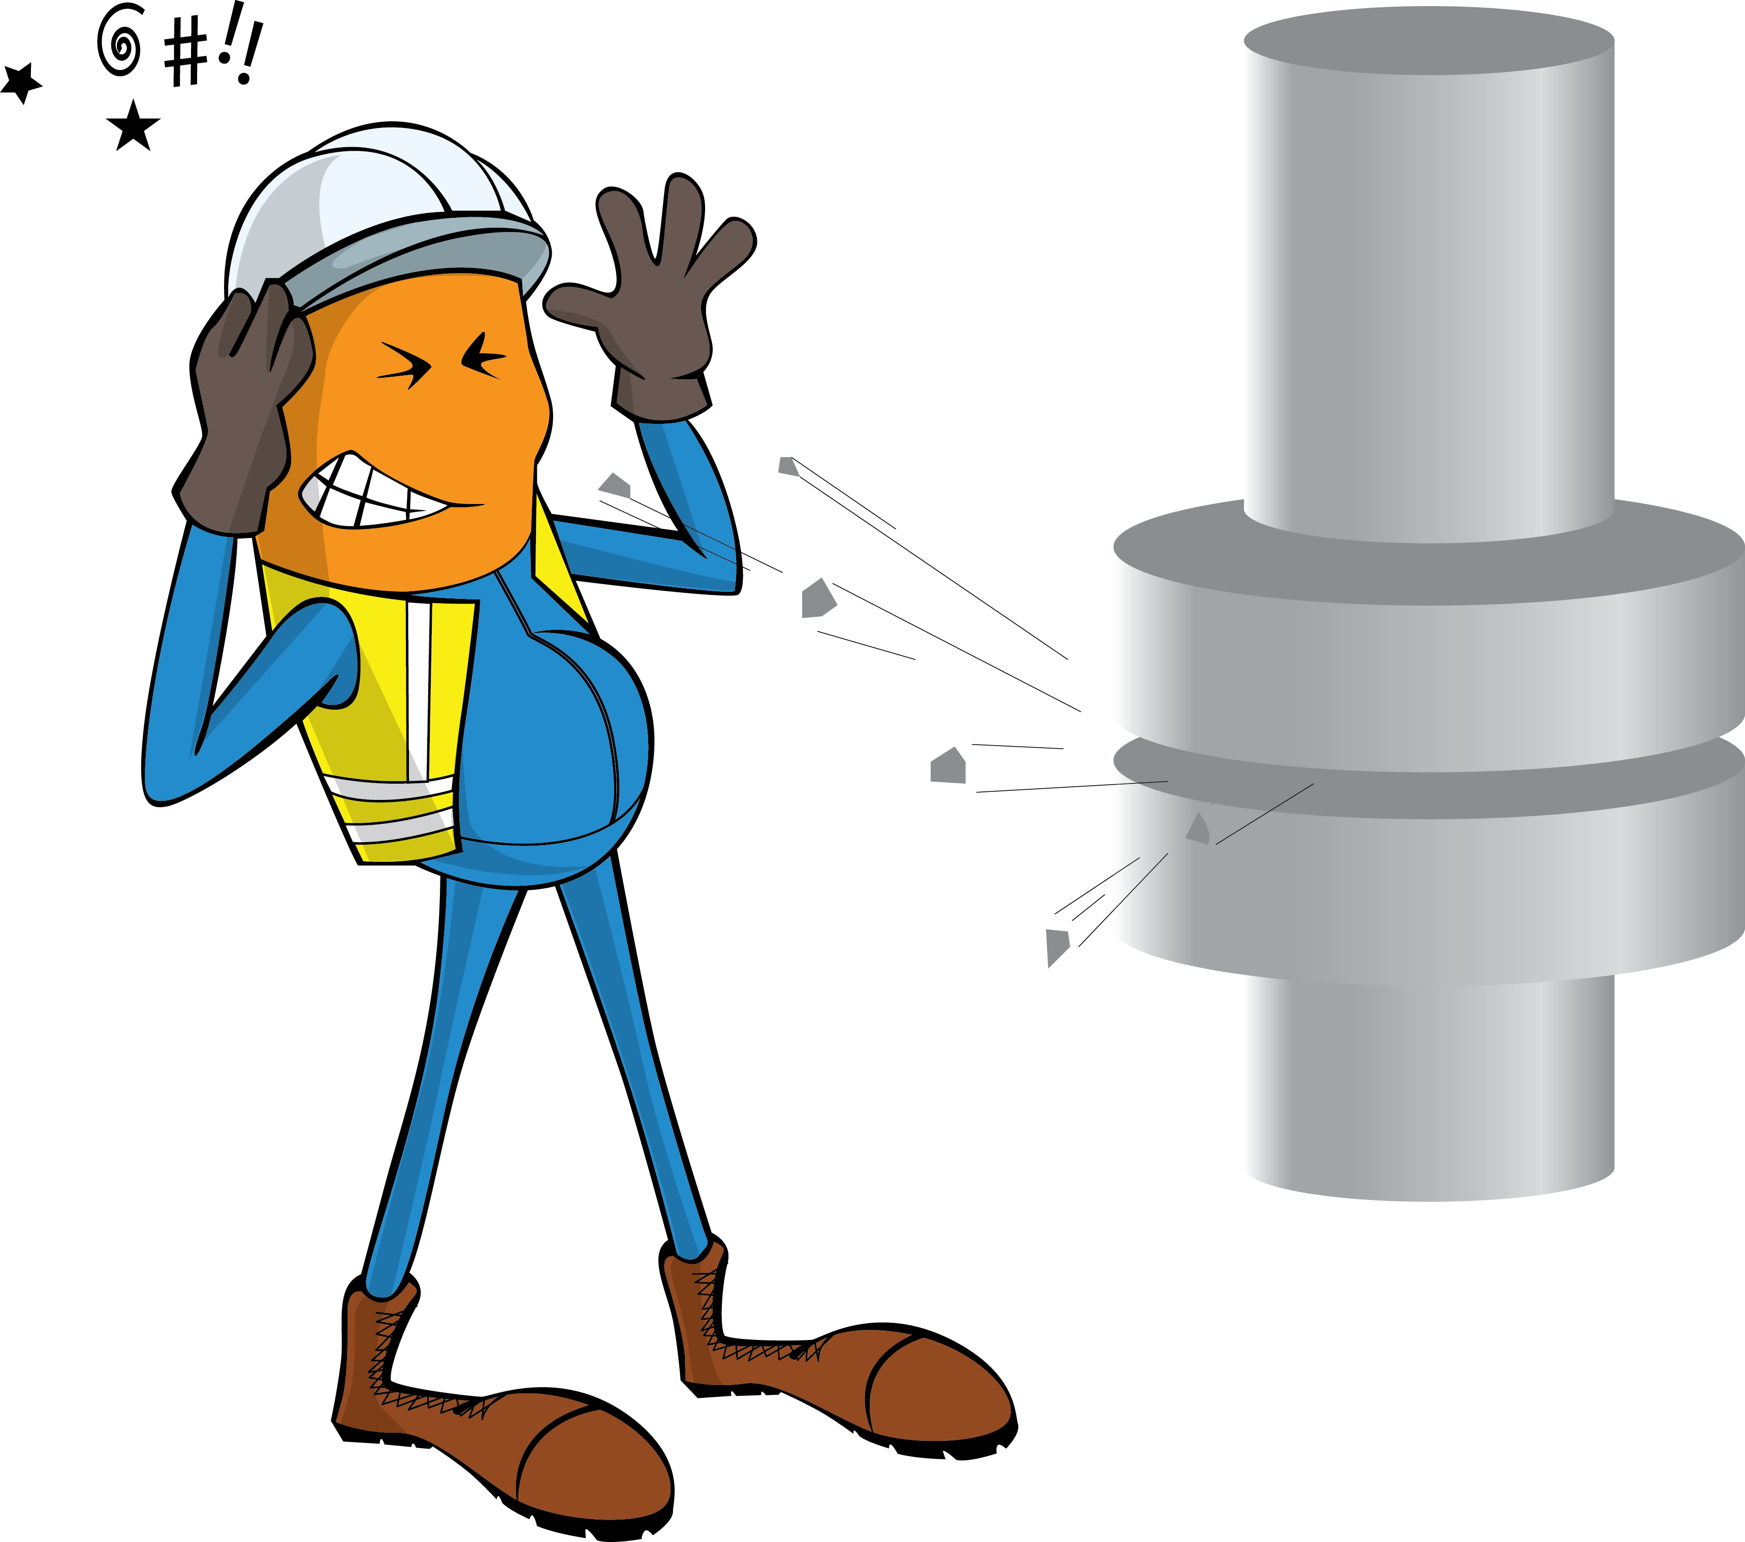
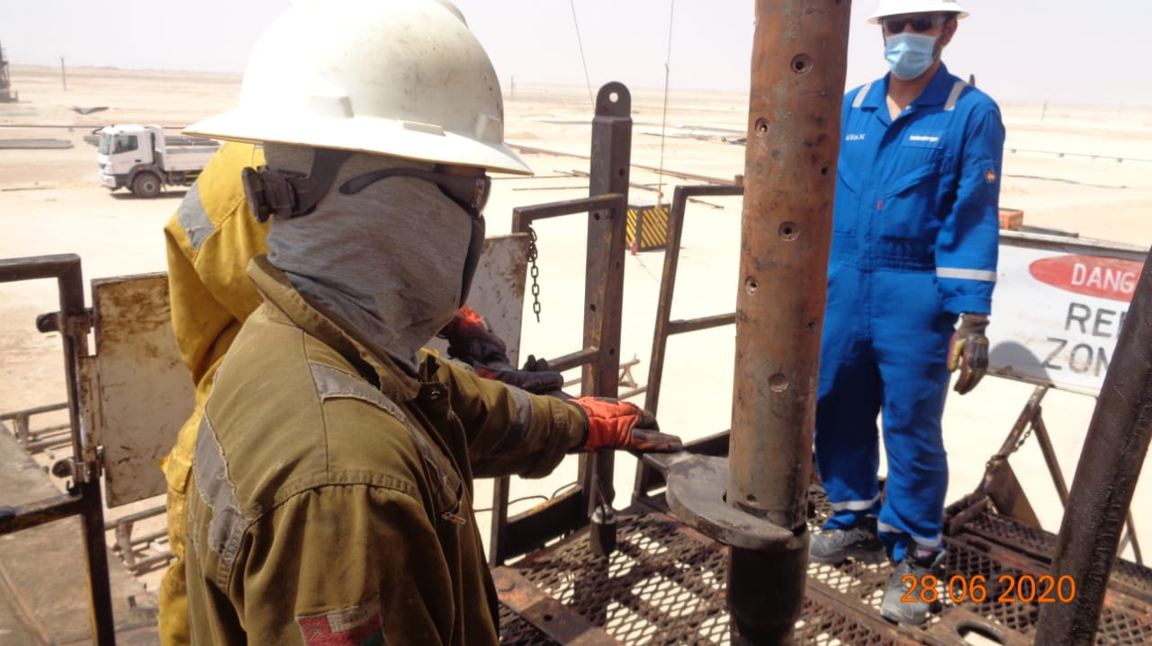
PDO Incident First Alert
Incident Type | LTI#13 | Pattern | Struck by
Date / Time | 27.06.2020@16:30hrs | Directorate
Location | Amal | Dept
Target Audience
Construction, Operations, Engineering, Drilling and Explorations
What happened
During POOH (Pulling out of hole), trapped pressure released from the perforation gun striking a Roustabout on the right side of his face resulting in a burn to his face.
Mr. Musleh asks the questions of can it happen to you?
How do you ensure you identify all hazards before starting a task?
Are you aware of the risk of stored energy?
Do you consider “what could go wrong?”
Are you in the ‘line of fire’?
Trapped pressure release point
Please disseminate this LTI notification to your teams and use it in your tool box talks and HSE meetings and notice boards.

