Slide 1
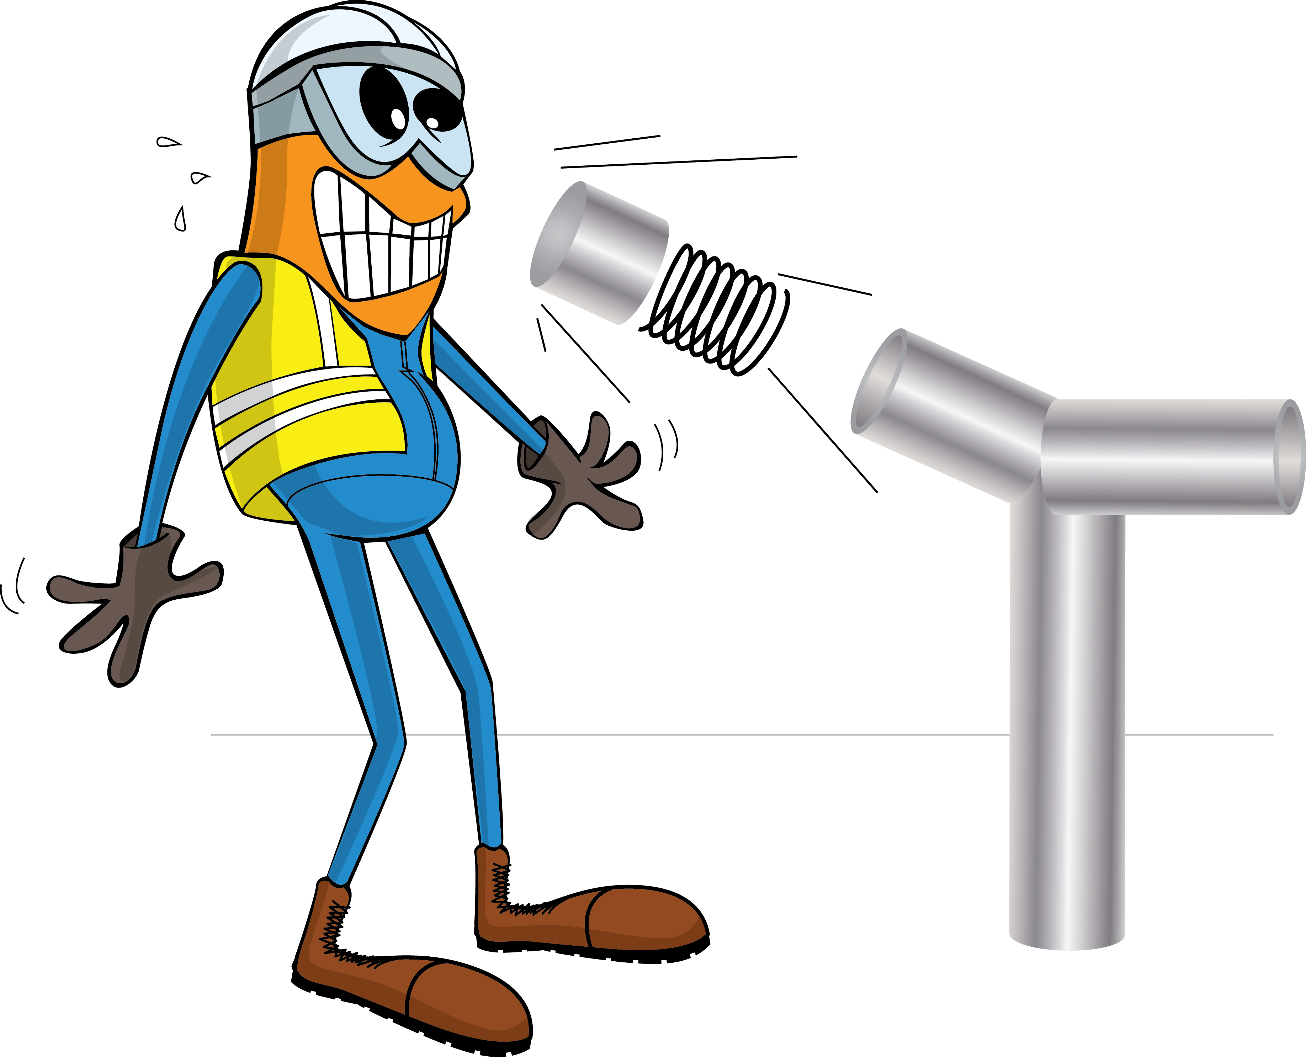
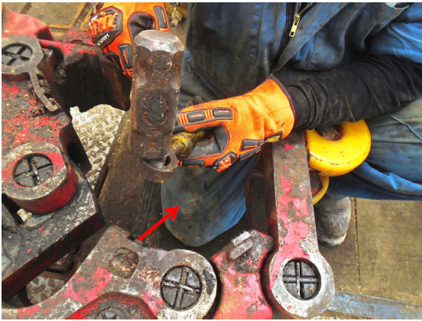
PDO Incident First Alert
Incident Type | LTI#14 | Pattern | Struck by
Date / Time | 03.07.2020@11:30hrs | Directorate
Location | Marmul | Dept
Target Audience
Drilling, Operations, Engineering, Construction & Logistics
What happened
While removing stuck dies from manual tong, a broken chip ejected striking and piercing through Floorman’s coverall and penetrating his right thigh.
Mr. Musleh asks the questions of can it happen to you?
How do you ensure you identify all hazards before starting a task?
Do you consider if you are away from ‘line of fire’ Projectiles?
Do you verify if you have the right tool for the task?
Splintered chip came from the dies
Please disseminate this LTI notification to your teams and use it in your tool box talks and HSE meetings and notice boards.

