Slide 1
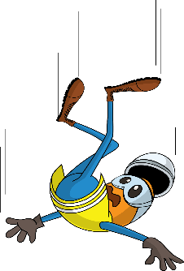
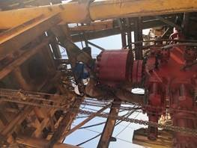
PDO Incident First Alert
Incident Type | LTI#15 | Pattern | Fall
Date / Time | 15.07.2020@16:00hrs | Directorate
Location | Qarn Alam | Dept
Target Audience
Drilling, Operations, Engineering, Construction & Logistics
What happened
While the Roustabout was attempting to remove the vent line, the flowline swung causing him to fall striking his left hand on the BOP. The Roustabout was attached with the fall arrestor.
Mr. Musleh asks the questions of can it happen to you?
Do you ensure you identify all hazards before starting a task?
Do you ensure you are in a safe position while performing a task?
Do you consider the risk of fall from height?
Do you consider any stored energy which can release at any time?
Where RA hit his hand
Please disseminate this LTI notification to your teams and use it in your tool box talks and HSE meetings and notice boards.

